Slide 1
Suppression of MAPKAPK2 in mammalian hibernation
Mitogen-activated protein kinase-activated protein kinase-2 in Richardson’s ground squirrels (Spermophilus Richardsonii)
Christopher A. Dieni
Margaret and Wallace McCain Postdoctoral Fellow
http://chrisdieni.com

Slide 2
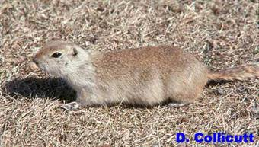

Slide 3
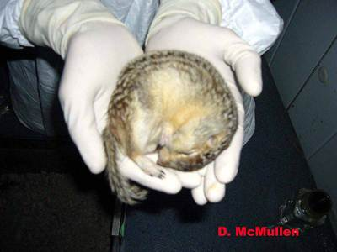

Slide 4
Hibernation-associated stresses and adaptations
Interspersion of long periods of torpor and short arousals to euthermia | Nutrient excess and mitochondrial stress (due to hyperphagia)
Heterothermy (low temperatures) | Broad oxygen consumption ranging from hypoxia to hyperoxia (reperfusion); oxidative stress
Metabolic rate depression | Massive reorganization of carbohydrate, lipid, and amino acid metabolism
Cardiac hyperthrophy | Ischemia

Slide 5
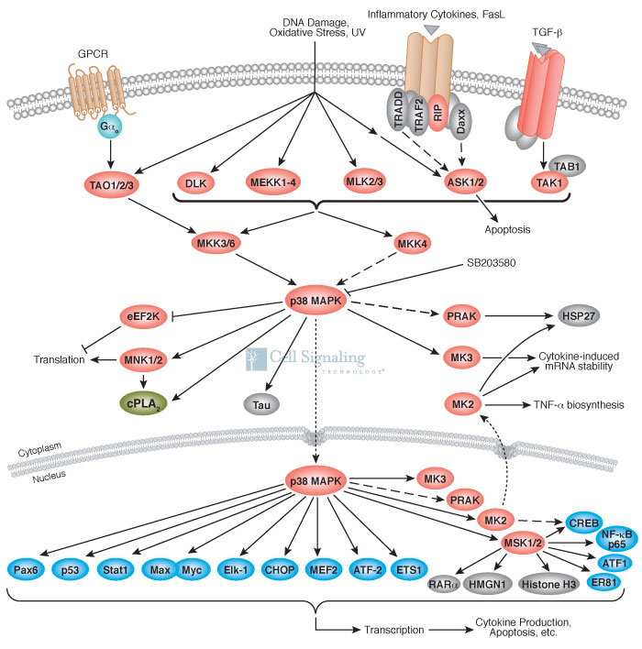

Slide 6
Known responses in hibernating Spermophilus muscle
?
?

Slide 7
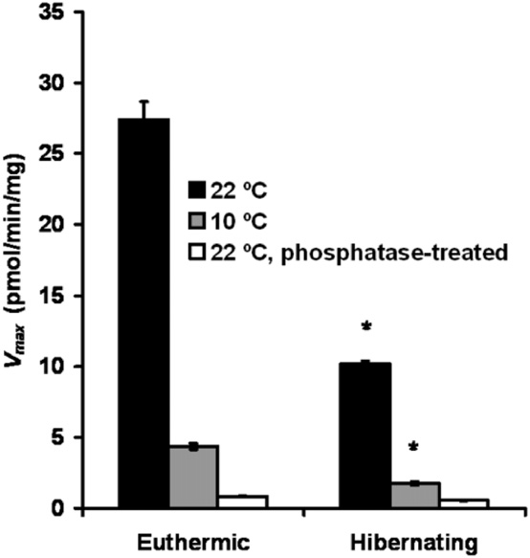
MAPKAPK2 isolated from hibernating vs. euthermic squirrels = ↓ ~63%
Even when assayed at lower temperature (10 °C), still similar decrease
When compounding physiology-mediated and temperature-mediated differences = ~6% of euthermic, warm-temperature value
Abnous et al., 2012

Slide 8
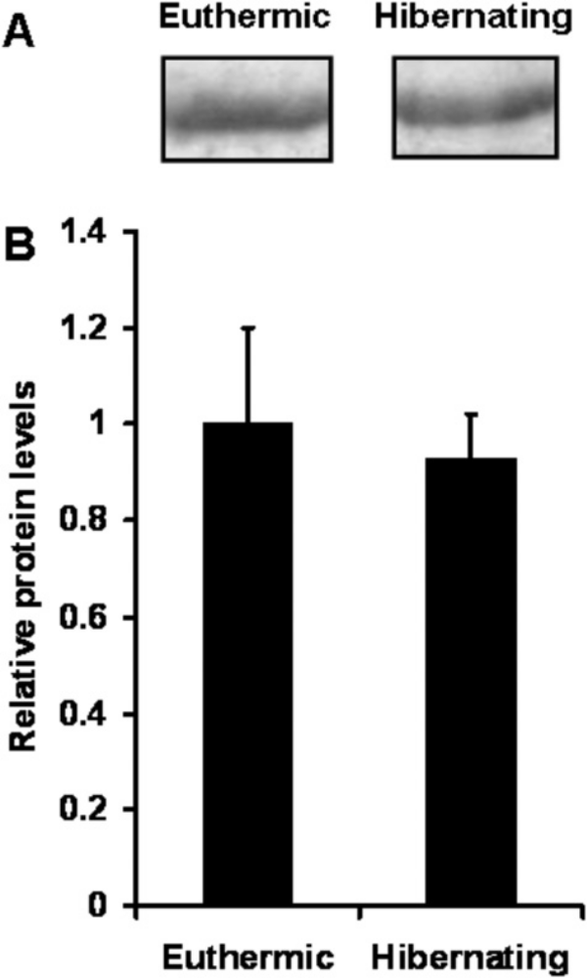
Are decreased activity levels between euthermic and hibernating squirrels the result of decreased protein levels?
No… total MAPKAPK2 protein remains the same
Are decreased activity levels due to post-translational modification?
Abnous et al., 2012

Slide 9
P
MAPKAPK2
MAPKAPK2
Phosphatase
MAPKAPK2
MAPKAPK2
Inactivate phosphatase
Assay

Slide 10
In vitro dephosphorylation reduces MAPKAPK2 activity to barely detectable in both cases
Abnous et al., 2012

Slide 11
P
MAPKAPK2
MAPKAPK2
MAPKAPK2
P
MAPKAPK2
MAPKAPK2
MAPKAPK2
P
MAPKAPK2
MAPKAPK2
MAPKAPK2
P
P
MAPKAPK2
MAPKAPK2
MAPKAPK2
P
MAPKAPK2
MAPKAPK2
MAPKAPK2
Euthermia
Hibernation
In vitro dephosphorylation

Slide 12
MAPKAPK2 inactivation seemingly at odds with other trends

Slide 13
Other targets of MAPKAPK2
P
MAPKAPK2
Glycogen synthase
Tyrosine hydroxylase
CREB
Akt
Hsp25/27
αB-crystallin
5-Lipooxygenase

Slide 14
MAPKAPK2 targets - expected phosphorylation state changes during hibernation
Increase | Decrease
Hsp25/27 | Akt*
CREB | 5-Lipooxygenase
Glycogen synthase | Tyrosine hydroxylase (?)
αB-crystallin
* Abnous, K., Dieni, C.A., Storey, K.B. (2008) Regulation of Akt during hibernation in Richardson’s ground squirrels. Biochim. Biophys. Acta 1780: 185-193.

Slide 15
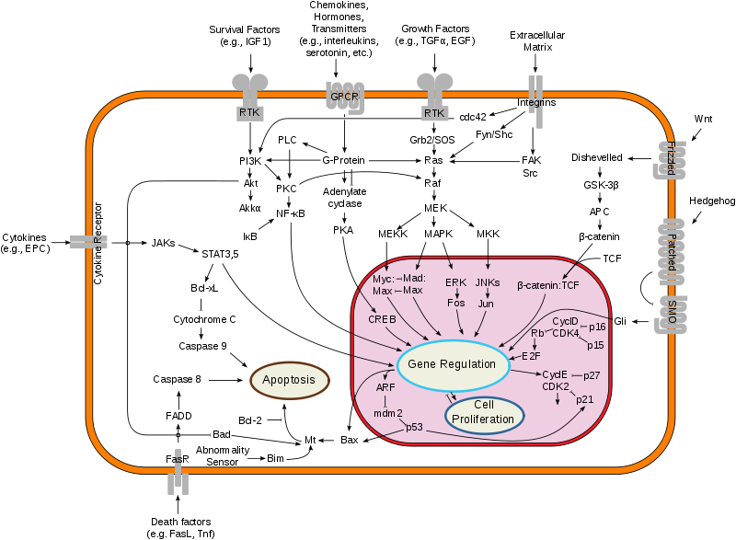
Future efforts
What mechanism (phosphatase?) promotes low phosphorylation state in MAPKAPK2 despite p38MAPK activation? |  | For MAPKAPK2 targets which should have increased phosphorylation in mammalian hibernation, which protein kinase is “compensating” for MAPKAPK2 suppression?

Slide 16
Thank you!
Abnous, K., Dieni, C.A., Storey, K.B. Suppression of MAPKAPK2 during mammalian hibernation. Cryobiology. In press.
http://chrisdieni.com
http://twitter.com/chrisdieni

