Slide 1
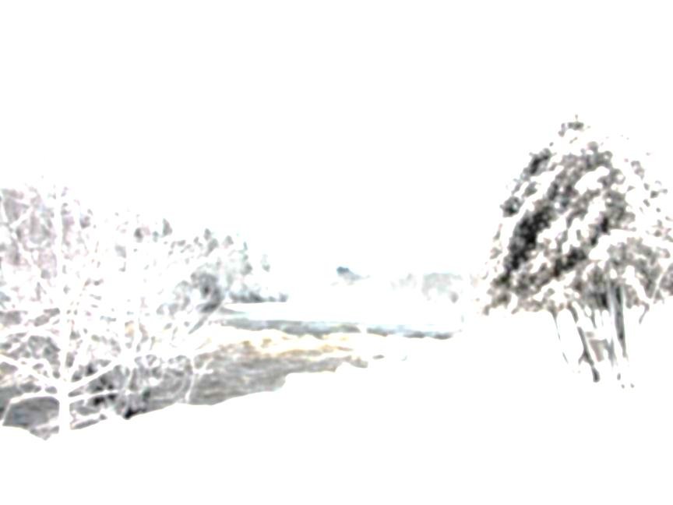

NATURAL ANSWERS / LES SOLUTIONS NATURELLES
Defences against human disease in the simplest of places / Des moyens des se défendre contre la maladie humaine trouvés dans les plus simple des lieux
MAFA Lunch and Learn Lecture Series
Moncton Public Library / Bibliotheque publique de Moncton
Christopher Anthony Dieni
Margaret and Wallace McCain Postdoctoral Fellow
Department of Chemistry and Biochemistry
Mount Allison University
http://chrisdieni.com

Slide 2
DIABETES / DIABÈTE
9 MILLION CANADIANS / 9 MILLION DE CANADIENS
~25%

Slide 3
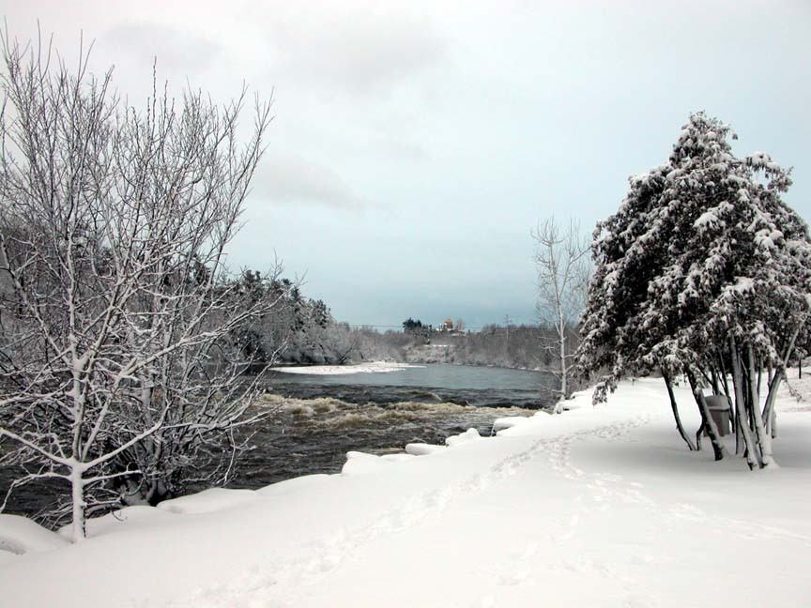

Slide 4
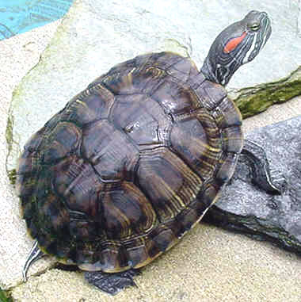
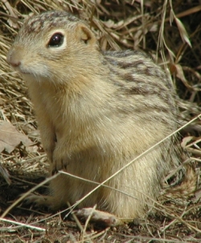
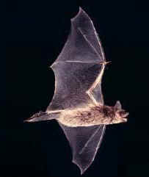
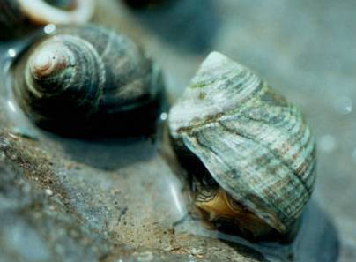
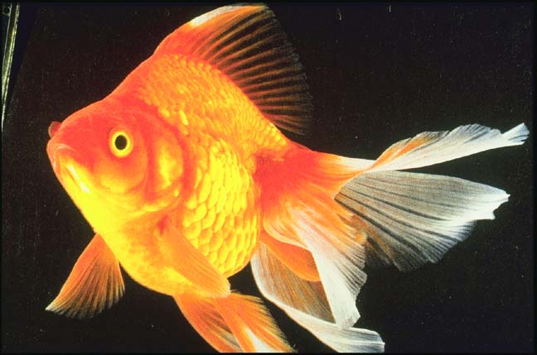
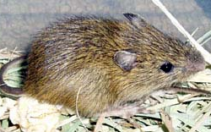
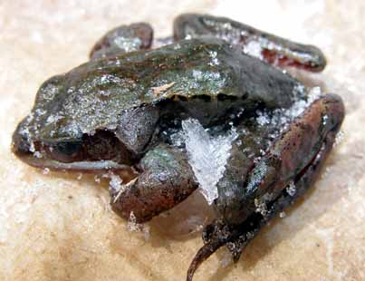
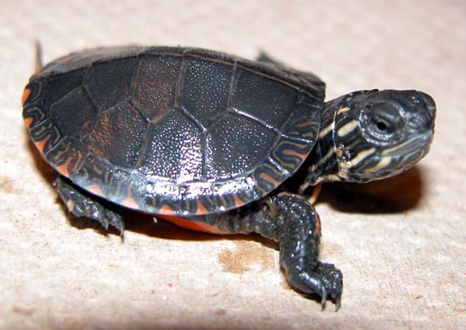
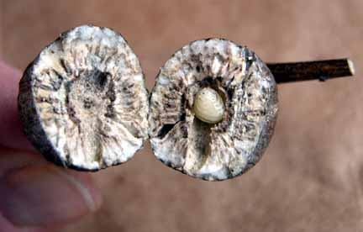
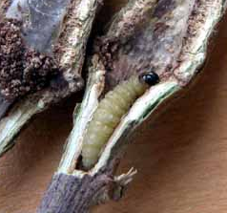
HYPOMETABOLISM /
HYPOMÉTABOLISME
Anoxia / Anoxie
Hibernation
Freezing / Gel
Diapause

Slide 5
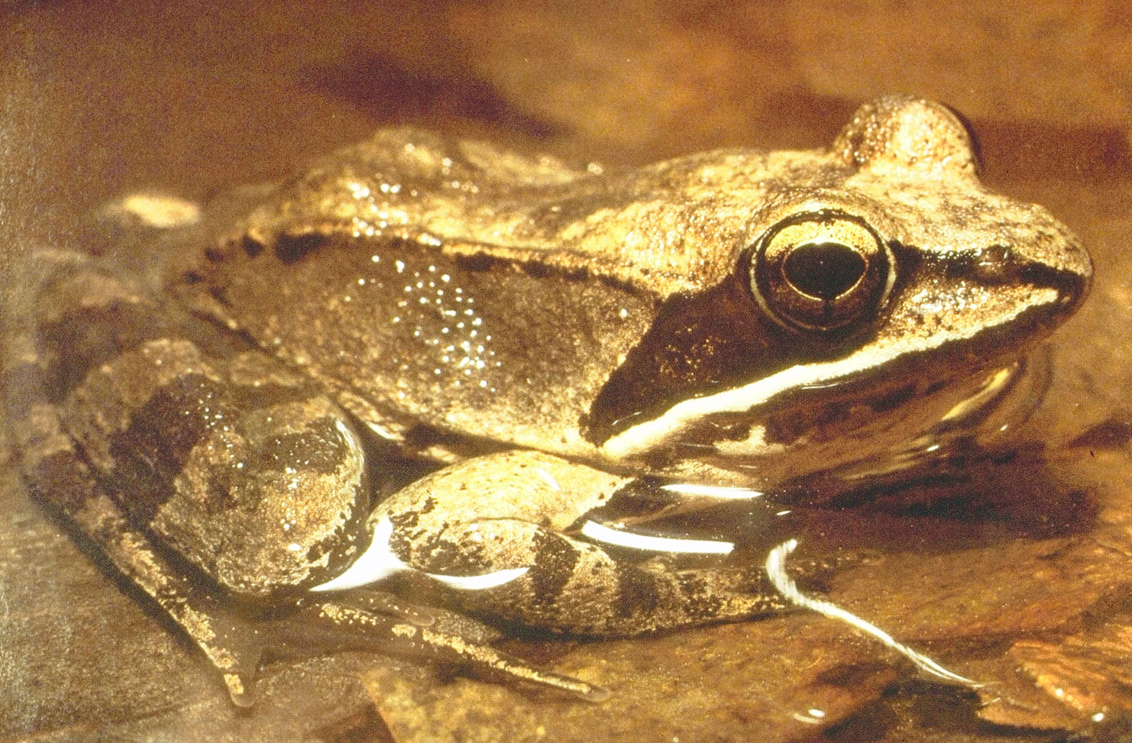
WOOD FROG / GRENOUILLE DE BOIS
Rana sylvatica

Slide 6
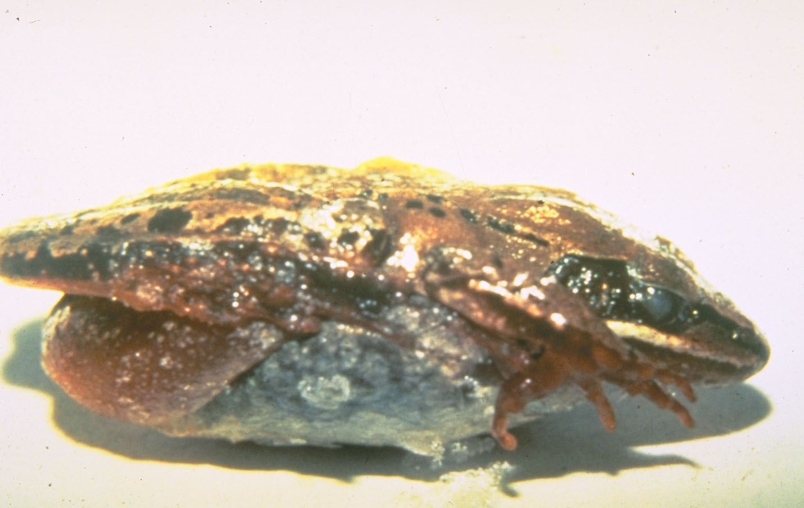
WOOD FROG / GRENOUILLE DE BOIS
Rana sylvatica

Slide 7
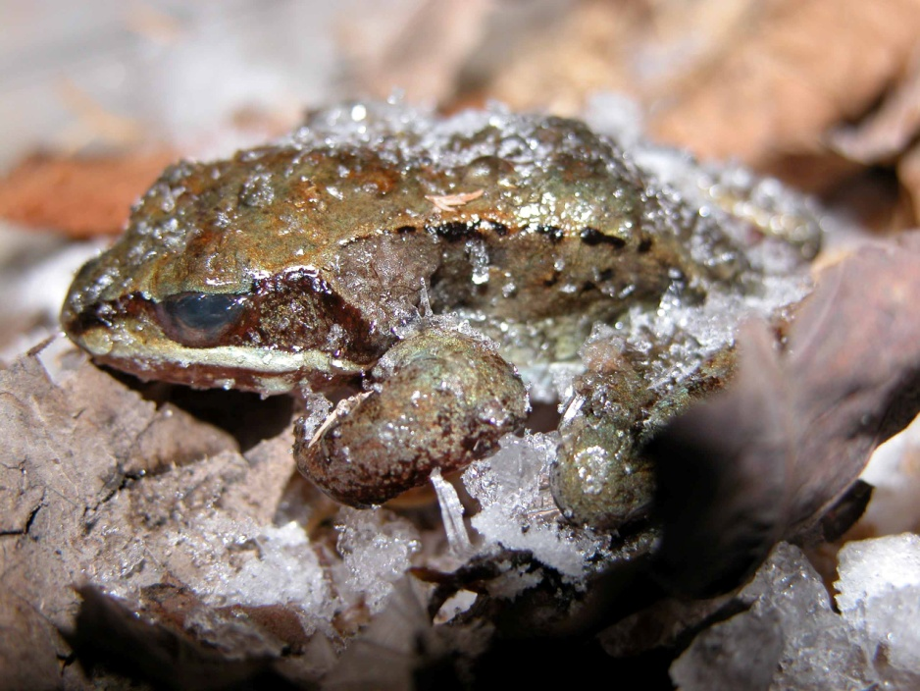
Frogs of various colours are numerous in those parts as far North as the latitude 61°….as the Winter approaches, they burrow under the moss, at a considerable distance from the water, where they remain in a frozen state till the Spring. I have frequently seen them dug up with the moss (when pitching tents in Winter) frozen as hard as ice; in which state the legs are as easily broken off as a pipe-stem, without giving the least sensation to the animal; but by wrapping them up in warm skins, and exposing them to a slow fire, they soon recover life…”. Samuel Hearne
A Journey from Prince of Wales’s fort in Hudson’s Bay to the Northern Ocean in the Years 1769-1772

Slide 8
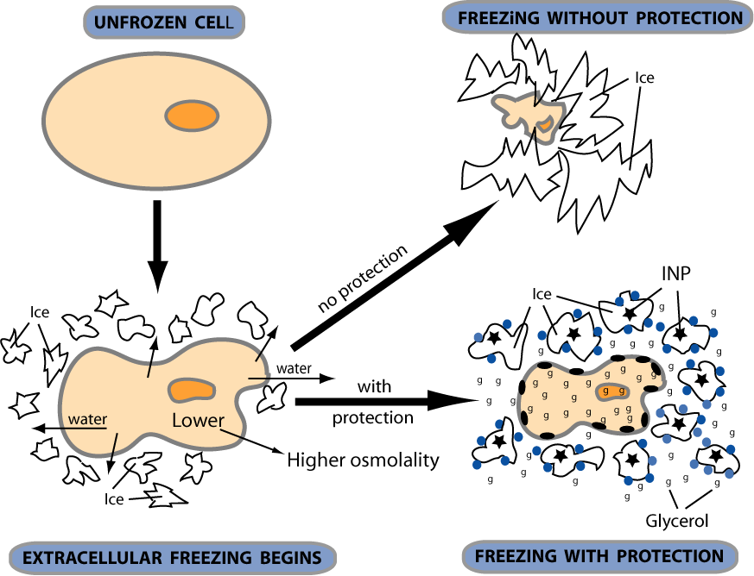
SURVIVING FREEZING / SURVIVRE À LA CONGÉLATION
Unfrozen / Dégelé
Without protection / Sans protection
Ice / Glace
Ice / Glace
Water / Eau
Ice / Glace
Freezing / Gel

Slide 9
SURVIVING FREEZING / SURVIVRE À LA CONGÉLATION
Unfrozen / Dégelé
Without protection / Sans protection
Ice / Glace
Protein / Protéine
Ice / Glace
Ice / Glace
Water / Eau
Ice / Glace
Glucose
Freezing / Gel
With protection / Avec protection

Slide 10
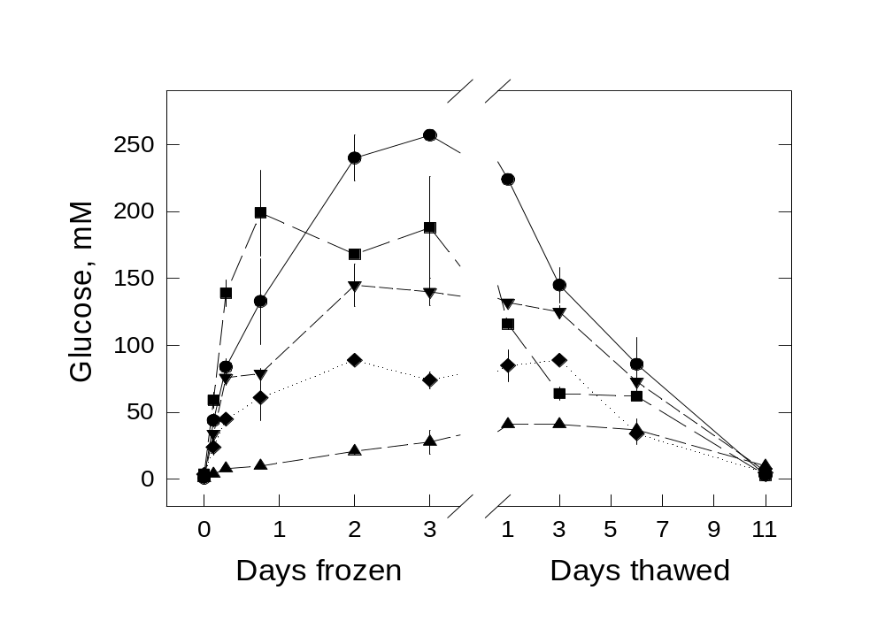
CRYOPROTECTANTS / CRYOPROTECTEURS
Blood / Sang
Liver / Foie
Heart / Coeur
Kidney / Rein
Muscle
Days / Jours
Frozen / Gelé
Thawed / Dégelé

Slide 11
CRYOPROTECTANTS / CRYOPROTECTEURS
~50 times normal blood glucose within 3 days of freezing / ~ 50 fois la glycémie normale en 3 jours de gel
Blood / Sang
Liver / Foie
Heart / Coeur
Kidney / Rein
Muscle
Days / Jours
Frozen / Gelé
Thawed / Dégelé

Slide 12
CRYOPROTECTANTS / CRYOPROTECTEURS
Blood / Sang
Normal blood glucose within less than 2 weeks of thawing / ~ Glycémie normale en moins de 2 semaines de dégel
Liver / Foie
Heart / Coeur
Kidney / Rein
Muscle
Days / Jours
Frozen / Gelé
Thawed / Dégelé

Slide 13
HYPOMETABOLISM /
HYPOMÉTABOLISME
Anoxia / Anoxie
Hibernation
Freezing / Gel
Diapause

Slide 14
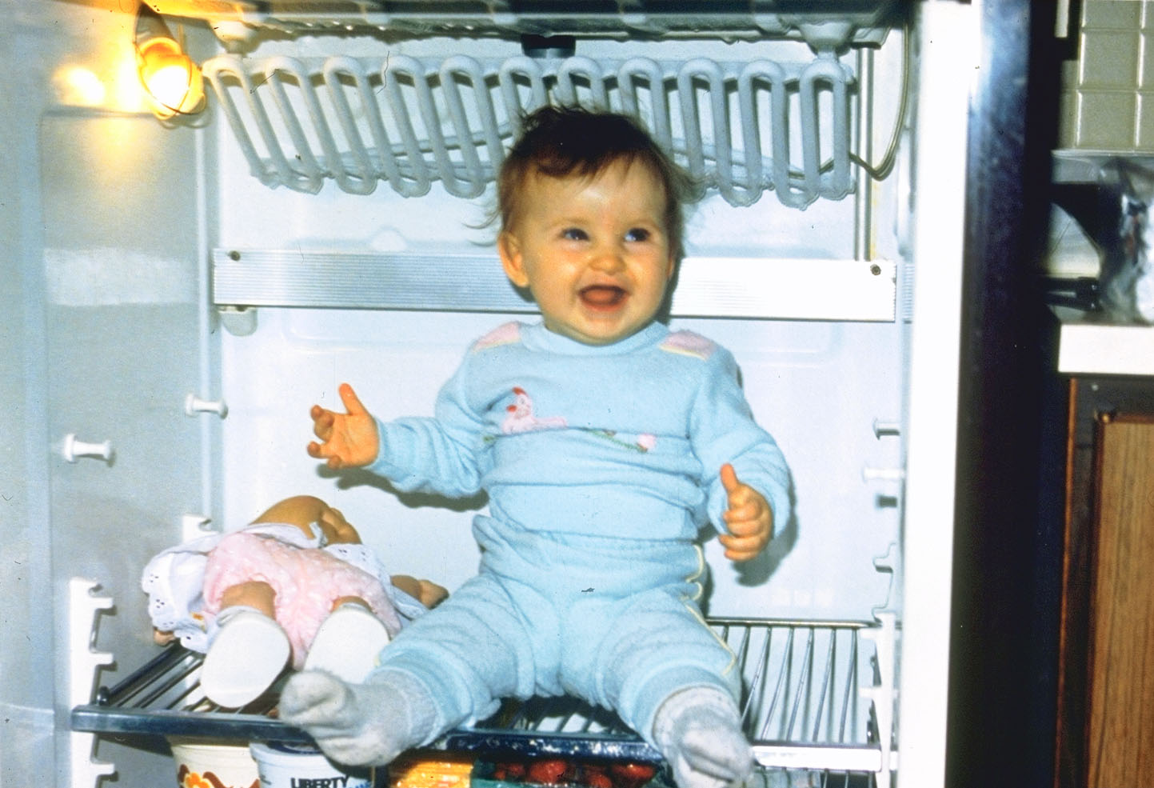
THE FUTURE? / LE FUTUR?

Slide 15
THANK YOU! / MERCI!
http://chrisdieni.com
http://twitter.com/chrisdieni

