Slide 1

Signal Transduction:
A small-class model for fully integrating learning and assessment
Christopher A. Dieni
Neal I. Callaghan
Alex M. Whynot
Department of Chemistry and Biochemistry, Mount Allison University
Association of Atlantic Universities 2013 Teaching Showcase

Slide 2
Signal Transduction (BIOC 4031)
Not a course that was “set in stone”
  Predecessor taught course once before me
  Before predecessor, plethora of other instructors over the years…
My exact area of expertise
The perfect scenario in which to “play!”

Slide 3
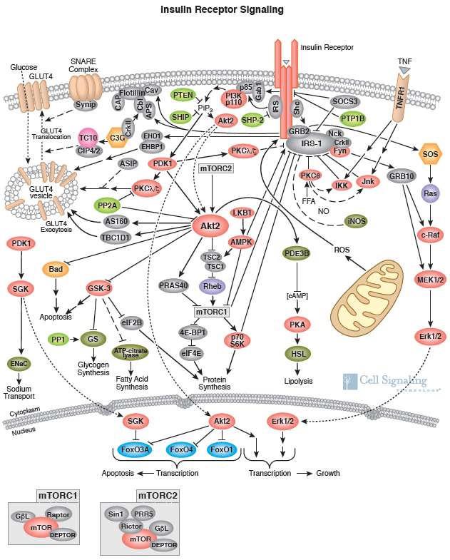
Reasonable to ask this on midterms and final exams?
Learning objectives?
Retention of knowledge?
Is there a point to having midterms or final exams at all?

Slide 4
Decision: “Exam-free zone”
No focus on memorization/regurgitation
Focus on:
  Analysis
  Comparison
  Integration
  Connection
Best way to do this: presentations and papers versus “timed” exam

Slide 5
Student presentations
Lectures
Student papers

Slide 6
Oral presentation #1
Assigned topic
5% of total grade
Written paper #1
Same topic as Oral presentation #1
5% of total grade
Oral presentation #2
Topic of student’s choosing
15% of total grade
Written paper #2
Same topic as Oral presentation #2
15% of total grade
Oral presentation #3
Topic of student’s choosing; can build upon Oral presentation #2
25% of total grade

Slide 7
Written paper #3
Same topic as Oral presentation #3
25% of total grade
10% participation grade

Slide 8
Oral presentation #1
Assigned topic
5% of total grade
Written paper #1
Same topic as Oral presentation #1
5% of total grade
Oral presentation #2
Topic of student’s choosing
15% of total grade
Written paper #2
Same topic as Oral presentation #2
15% of total grade
Oral presentation #3
Topic of student’s choosing; can build upon Oral presentation #2
25% of total grade

Slide 9
Oral presentation #1
Assigned topic
5% of total grade
Feedback
Written paper #1
Same topic as Oral presentation #1
5% of total grade
Feedback
Oral presentation #2
Topic of student’s choosing
15% of total grade
Feedback
Written paper #2
Same topic as Oral presentation #2
15% of total grade
Feedback
Oral presentation #3
Topic of student’s choosing; can build upon Oral presentation #2
25% of total grade
Feedback

Slide 10
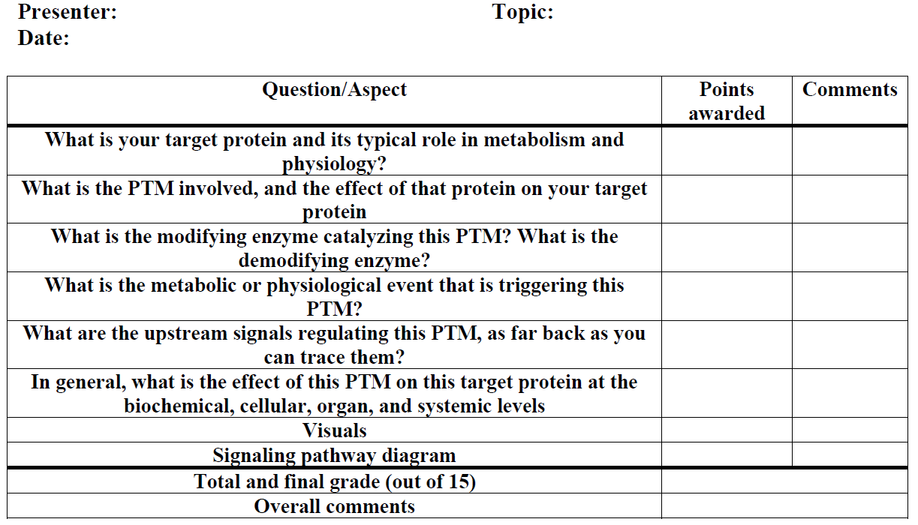

Slide 11
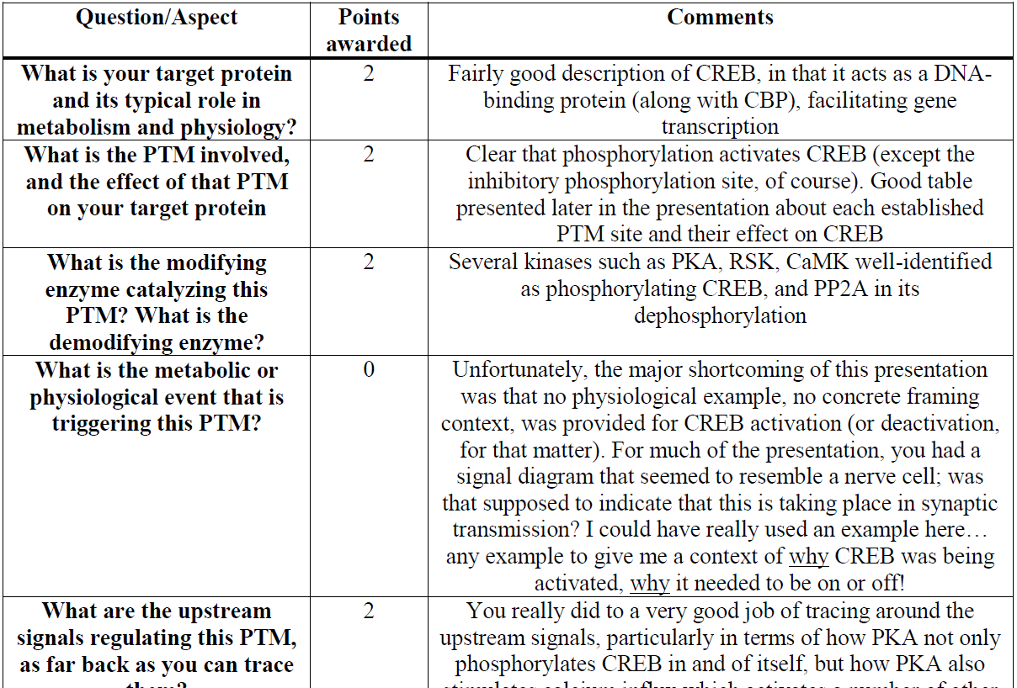

Slide 12
Student presentations
Lectures
Student papers

Slide 13
Student presentations
Lectures
Student papers
Feedback

Slide 14
Goal 1: Students can improve from oral presentation to written paper
  E.g. improve upon any deficiencies from presentation #2 to paper #2
Student presentations
Lectures
Student papers
Feedback

Slide 15
Goal 2: Students can improve from presentation to presentation
Not repeat any mistakes or shortcomings from presentation #2 to presentation #3
Student presentations
Lectures
Student papers
Feedback

Slide 16
Goal 3: Students can improve from paper to paper
Not repeat any mistakes or shortcomings from paper #2 to paper #3
Student presentations
Lectures
Student papers
Feedback

Slide 17
Goal 4: Students have increased appreciation for the lecture material, the finer points they should be absorbing, the importance, etc.
Student presentations
Lectures
Student papers
Feedback

Slide 18
Caveats
This worked with a very small class size (10)
  Could it work with:
    15 students?
    20 students?
    40 students?
    80 students?
    Etc.
So much feedback and opportunity for correction that the challenge was removed from the course

Slide 19
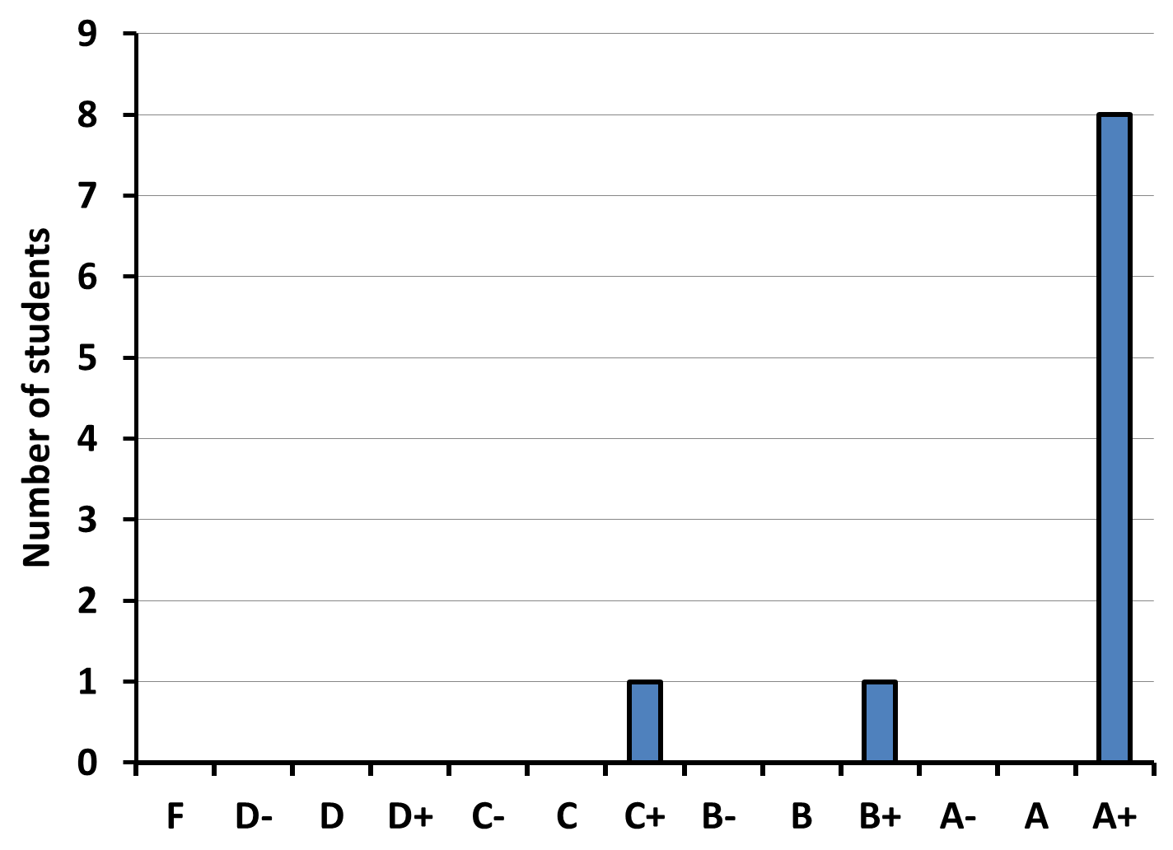
Grade “distribution”

Slide 20
Student perspective

Slide 21
No tests or short, focused assignments
  Limits diversity of assessment methods
Students able to apply concepts to own interests
Students able to customize style and approach to papers, presentations as desired
Notes:
2 Took basic principles from lectures, customized with my own personal scientific interests. Ex. Regulation of LDH
3 Ex contextual pictures distract me, but diagrams don’t- my slides look very different from another classmate’s

Slide 22
Each assignment relatively mark-heavy
  A single poor performance can significantly impair grades
Hard to get to that point…
Notes:
That being said

Slide 23
Real-time feedback
  Draft reviews
  Presentation reviewed before paper due
More difficult in larger classes

Slide 24
Integrative, holistic approach
  Each presentation/paper by its nature requires both detailed analysis, and big picture explanation of its relevance
  Stresses application of concepts and total understanding

Slide 25
Allowed for exposure to a wide range of topics, and an equally-wide range of presentation styles

Slide 26
Allowed maximum exposure to current literature
Notes:
Aside from lectures, every single fact presented by students was current peer-reviewed literature

Slide 27
In conclusion…
Method has inherent shortcomings
These are largely self-mitigated
Only truly limiting factor is class size
  Workload for professor

Slide 28
A Course Comparison (1)
BIOC-4031 Signal Transduction
BIOC-3041 Nucleic Acids Biochemistry
Number of Students: 10
Format: Lecture Only
Relatively Dense Material
Highly Competent Professors (Dr. Dieni)
Number of Students: 12
Format: Lecture Only
Relatively Dense Material
Highly Competent Professors (Dr. Waller)
**Same mark was received for each of these classes

Slide 29
A Course Comparison (2)
BIOC-4031 Signal Transduction
BIOC-3041 Nucleic Acids Biochemistry
Three Seminars (5%, 15%, 25%)
Three Papers (5%, 15%, 25%)
Participation (10%)
Bi-weekly Quizzes (20%)
An Assignment (20%)
Mid-term examination (20%)
Final Examination (40%)
As you can see there are clear differences between
the structure of these courses

Slide 30
But from a students point of view, what’s better?
Characteristics that I consider to make a “better” course:
  is structured in a way that there is “flow”
  demonstrates applications of the concepts beyond the classroom
  engages students in meaningful discussion
  the Professor is available outside of class hours
  provides assessment that can be applied and utilized in future work

Slide 31
But from a students point of view, what’s better?
Characteristics that I consider to make a “better” course:
  is structured in a way that there is “flow”
  demonstrates applications of the concepts beyond the classroom
  engages students in meaningful discussion
  the Professor is available outside of class hours
  provides assessment that can be applied and utilized in future work

Slide 32
A Course Comparison (2)
BIOC-4031 Signal Transduction
BIOC-3041 Nucleic Acids Biochemistry
Three Seminars (5%, 15%, 25%)
Three Papers (5%, 15%, 25%)
Participation (10%)
Bi-weekly Quizzes (20%)
An Assignment (20%)
Mid-term examination (20%)
Final Examination (40%)
Characteristics that I consider to make a “better” course:
  is structured in a way that there is “flow”
  demonstrates applications of the concepts beyond the classroom
  engages students in meaningful discussion
  the Professor is available outside of class hours
  provides assessment that can be applied and utilized in future work

Slide 33
A Course Comparison (2)
BIOC-4031 Signal Transduction
BIOC-3041 Nucleic Acids Biochemistry
Three Seminars (5%, 15%, 25%)
Three Papers (5%, 15%, 25%)
Participation (10%)
Bi-weekly Quizzes (20%)
An Assignment (20%)
Mid-term examination (20%)
Final Examination (40%)
Characteristics that I consider to make a “better” course:
  is structured in a way that there is “flow”
  demonstrates applications of the concepts beyond the classroom
  engages students in meaningful discussion
  the Professor is available outside of class hours
  provides assessment that can be applied and utilized in future work

Slide 34
A Course Comparison (2)
BIOC-4031 Signal Transduction
BIOC-3041 Nucleic Acids Biochemistry
Three Seminars (5%, 15%, 25%)
Three Papers (5%, 15%, 25%)
Participation (10%)
Bi-weekly Quizzes (20%)
An Assignment (20%)
Mid-term examination (20%)
Final Examination (40%)
Characteristics that I consider to make a “better” course:
  is structured in a way that there is “flow”
  demonstrates applications of the concepts beyond the classroom
  engages students in meaningful discussion
  the Professor is available outside of class hours
  provides assessment that can be applied and utilized in future work

Slide 35
A Course Comparison (2)
BIOC-4031 Signal Transduction
BIOC-3041 Nucleic Acids Biochemistry
Three Seminars (5%, 15%, 25%)
Three Papers (5%, 15%, 25%)
Participation (10%)
Bi-weekly Quizzes (20%)
An Assignment (20%)
Mid-term examination (20%)
Final Examination (40%)
Characteristics that I consider to make a “better” course:
  is structured in a way that there is “flow”
  demonstrates applications of the concepts beyond the classroom
  engages students in meaningful discussion
  the Professor is available outside of class hours
  provides assessment that can be applied and utilized in future work

Slide 36
Thank you!
Christopher A. Dieni – cdieni@mta.ca
Neal I. Callaghan – nicallaghan@mta.ca
Alex M. Whynot – amwhynot@mta.ca
http://chrisdieni.com

