Slide 1

Trail of breadcrumbs
Discovering the molecular mechanisms of nanotoxicity in fish
Christopher Anthony Dieni
Department of Chemistry and Biochemistry
Mount Allison University
UNB Biology Seminar Series
Friday, March 28th, 2014
Michael Owens

Slide 2
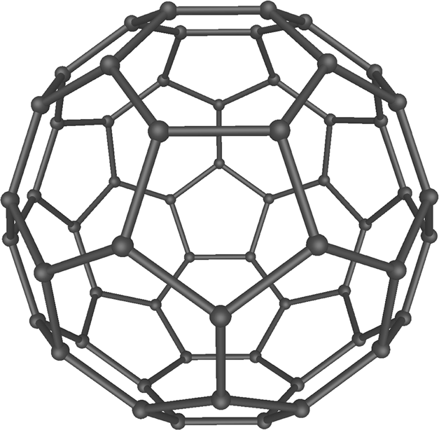
Nanotechnology
Origins traced back to the mid-20th century
  Physicist Richard Feynman delivers his talk “There’s Plenty of Room at the Bottom” – American Physical Society meeting at Caltech, December 29, 1959
In more than a half-century since then, we have become dependent on nanotechnology for:
  Biosensors
  Antimicrobial agents
  Drug delivery
  Molecular scale electronics
  Nanorobotics
  … and much more!
Wikimedia Commons

Slide 3
Today’s talk
Design of nanomaterials and constituent materials
Synthesis/engineering of nanomaterials
Functionalization/conjugation of nanomaterials for specific purposes (e.g. drug delivery)

Slide 4
Today’s talk
Design of nanomaterials and constituent materials
Synthesis/engineering of nanomaterials
Functionalization/conjugation of nanomaterials for specific purposes (e.g. drug delivery)
Release of nanomaterials in the environment and interaction with indigenous organisms

Slide 5
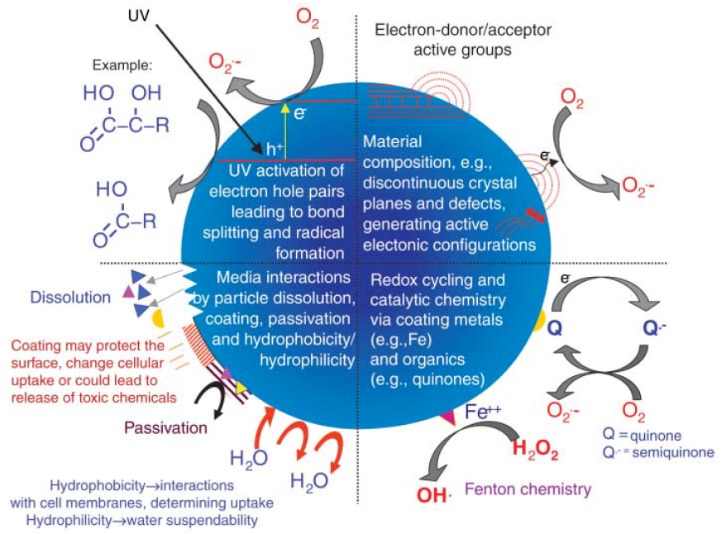
Nanoparticle toxicity
Nel, A. et al. (2006) Toxic potential of materials at the nanolevel. Science 311: 622-627

Slide 6
Nanoparticle toxicity
Nel, A. et al. (2006) Toxic potential of materials at the nanolevel. Science 311: 622-627

Slide 7
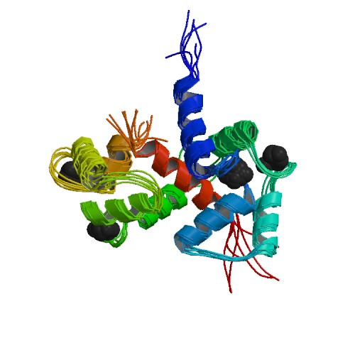
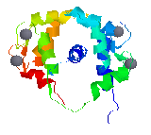
Nanoparticle-protein interactions
University of Massachusetts

Slide 8
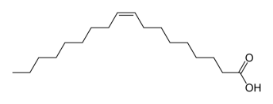
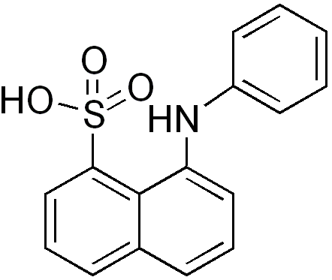
Nanoparticle-protein interactions
University of Massachusetts

Slide 9
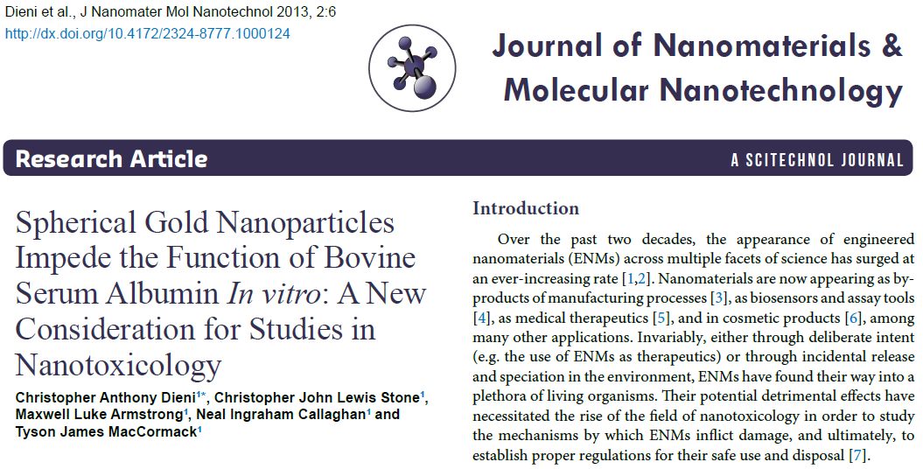
Nanoparticle-protein interactions
University of Massachusetts

Slide 10
Nanoparticle toxicity
Nel, A. et al. (2006) Toxic potential of materials at the nanolevel. Science 311: 622-627

Slide 11
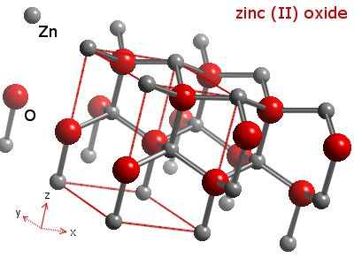
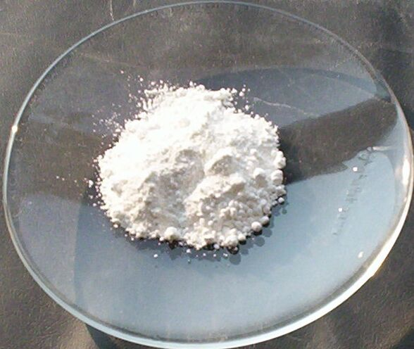
Model nanoparticle: nanoscale zinc oxide (nZnO)
WebElements.com
Wikimedia commons

Slide 12
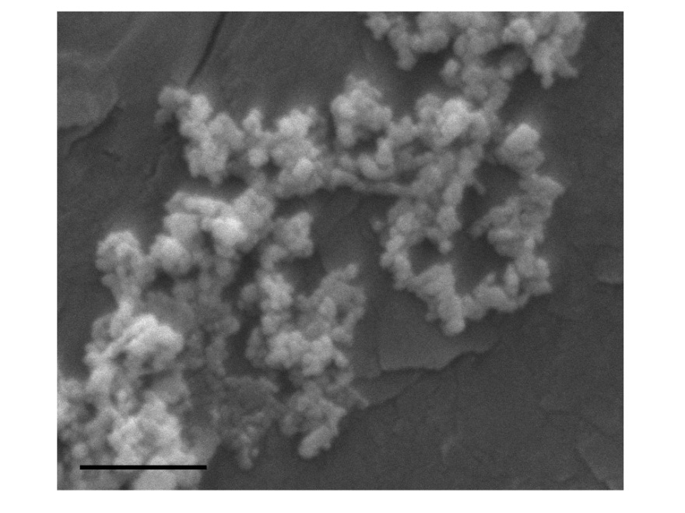
25 nm nZnO
Dieni et al. Comp Biochem Physiol Toxicol Pharmacol in press
Scale bar = 1 µm

Slide 13
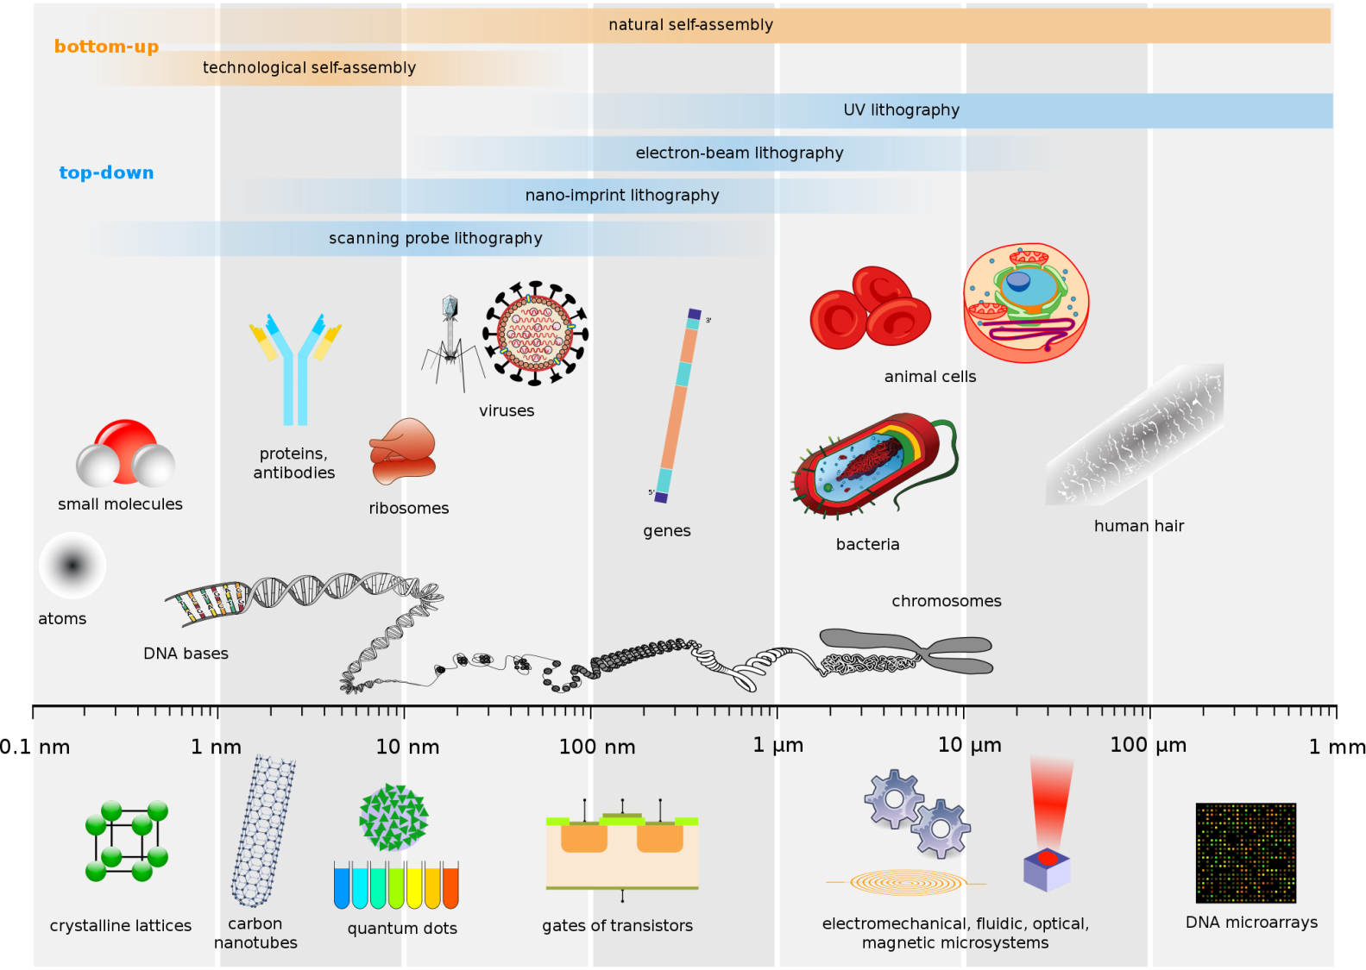
25 nm nZnO
Dieni et al. Comp Biochem Physiol Toxicol Pharmacol in press
Scale bar = 1 µm
Wikimedia commons

Slide 14
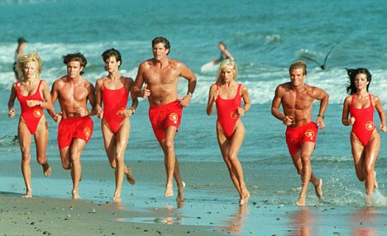
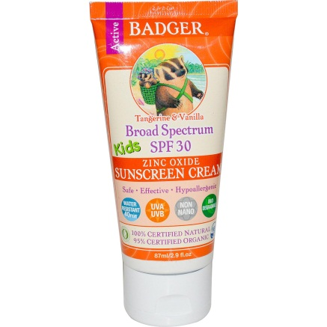
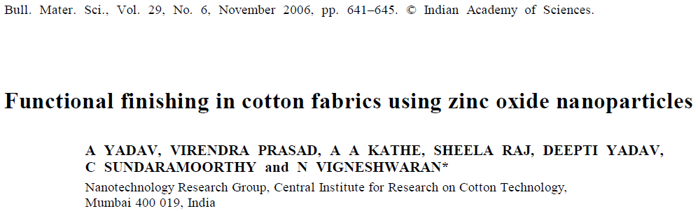
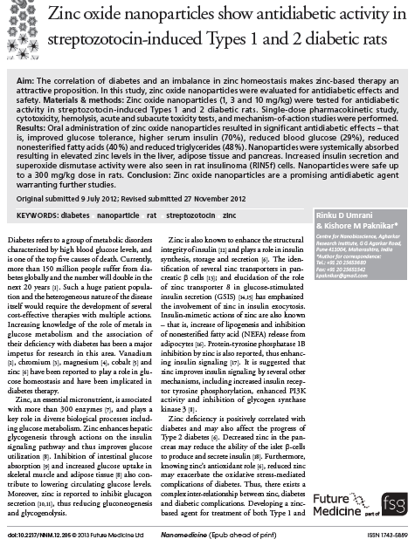
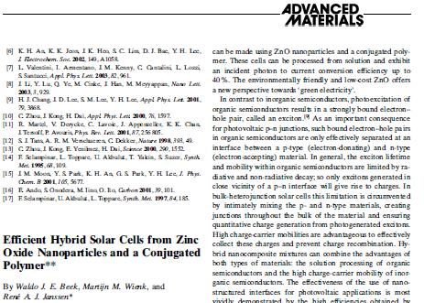
Uses of nZnO
UK Daily Mail

Slide 15
Nanotoxin?
In vivo exposure
In vitro “exposure”
Live physiological/systemic
(e.g. cardiorespiratory physiology)
Postmortem biochemical assays
(e.g. antioxidant enzymes, damage markers)
Complex media
(e.g. pooled rat blood plasma)
Simplified conditions
(e.g. BSA solution)

Slide 16
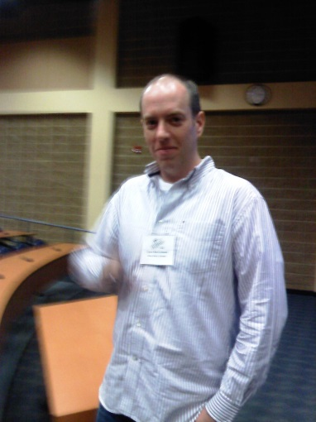
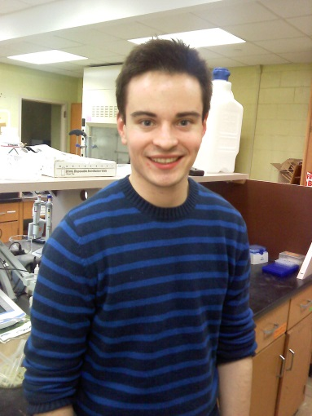
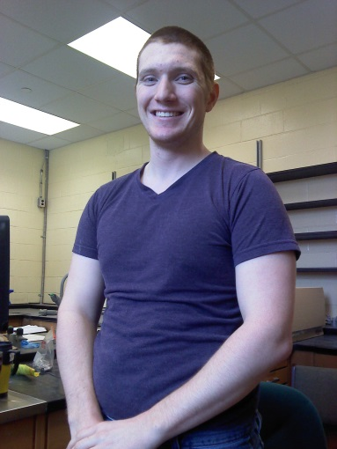
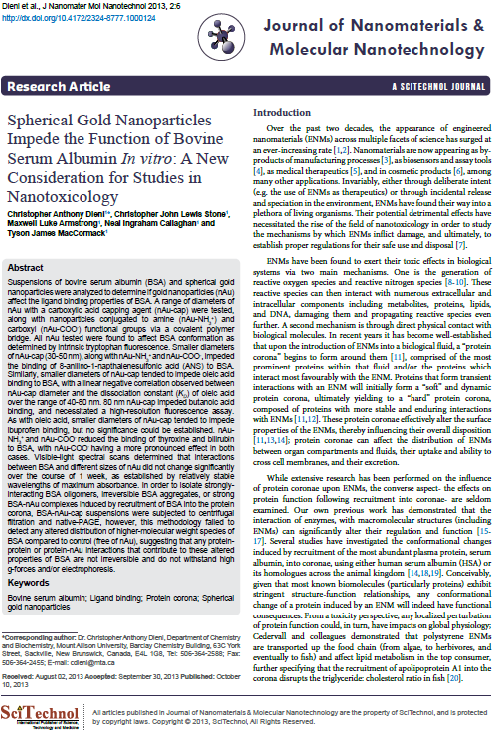
Nanotoxin?
In vivo exposure
In vitro “exposure”
Live physiological/systemic
(e.g. cardiorespiratory physiology)
Postmortem biochemical assays
(e.g. antioxidant enzymes, damage markers)
Complex media
(e.g. pooled rat blood plasma)
Simplified conditions
(e.g. BSA solution)

Slide 17
Nanotoxin?
In vivo exposure
In vitro “exposure”
Live physiological/systemic
(e.g. cardiorespiratory physiology)
Postmortem biochemical assays
(e.g. antioxidant enzymes, damage markers)
Complex media
(e.g. pooled rat blood plasma)
Simplified conditions
(e.g. BSA solution)

Slide 18
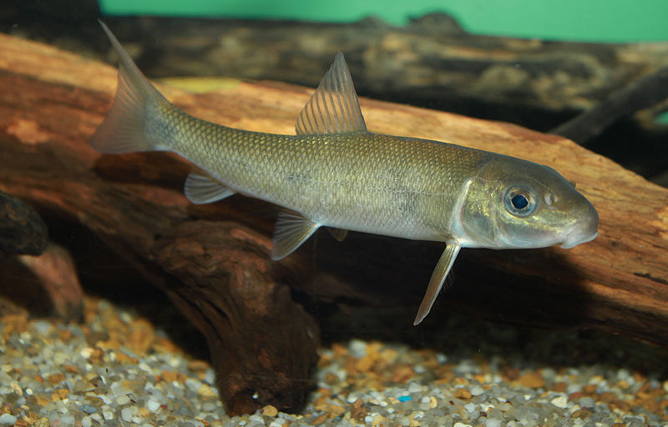
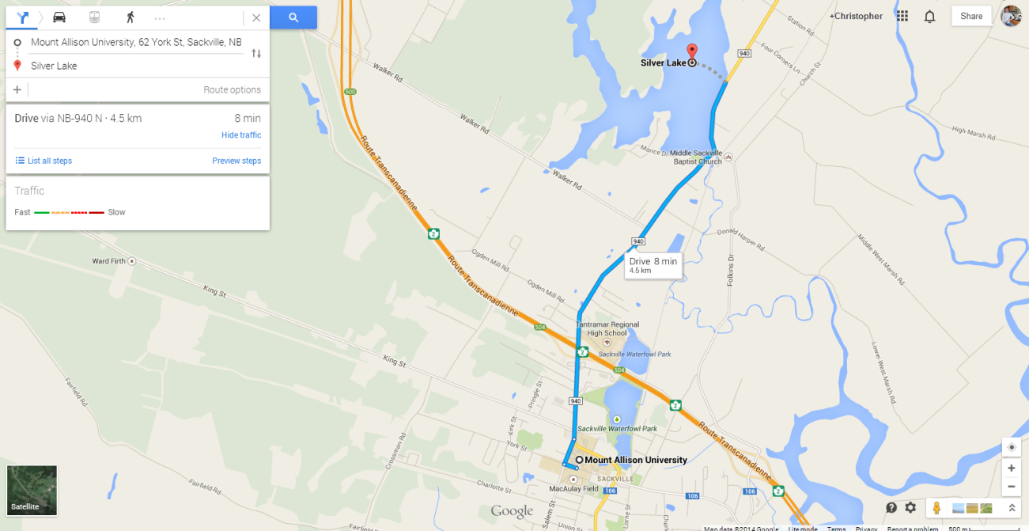
The white sucker, Catostomus commersonii
Benthic (bottom-feeding)
Likely to come into contact with well-dispersed or sedimentary nanoparticles
Easily accessible (Silver Lake)
1 mg/L nZnO
30 hours

Slide 19
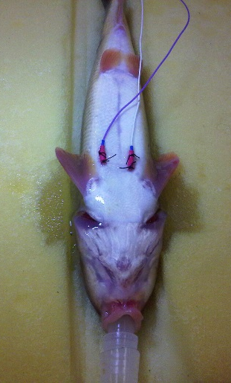
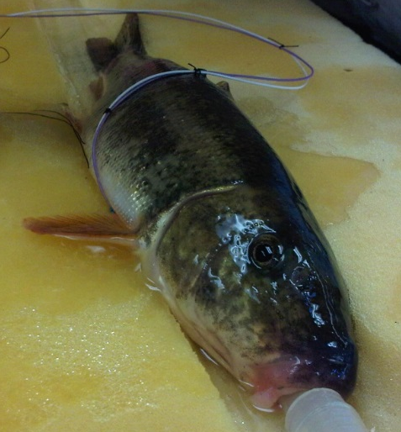
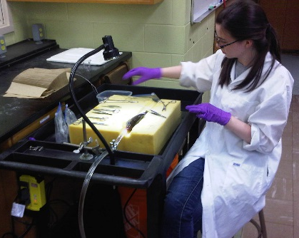
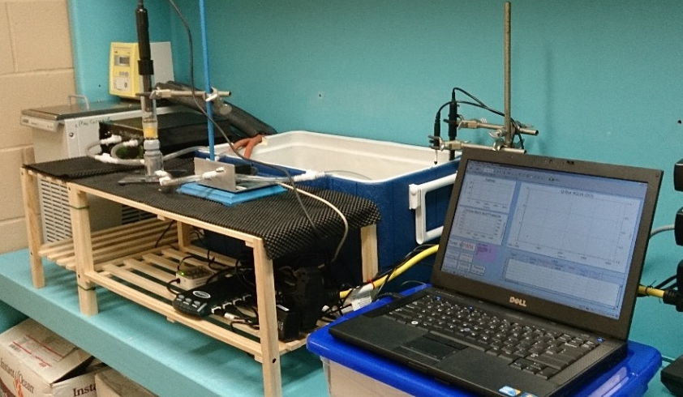
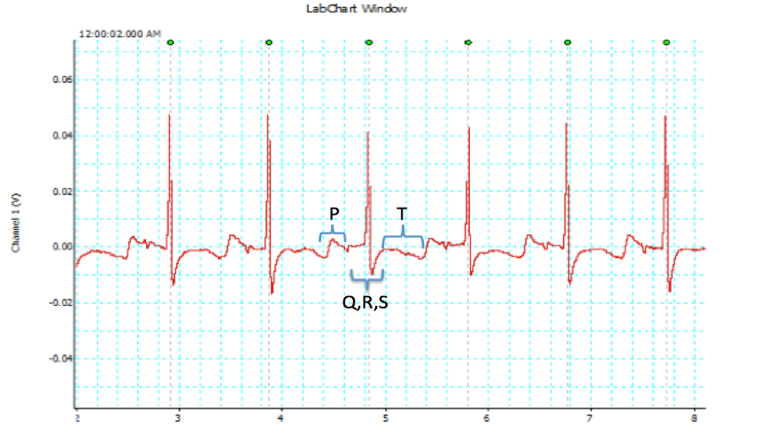
Live physiological/systemic level
Electrocardiography
Respirometry (resting MO₂)
Kathryn M. A. Butler, B.Sc. Biochem (Hons) 2013
Dr. Tyson J. MacCormack

Slide 20
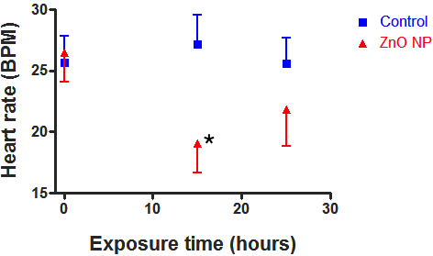
Live physiological/systemic level
Electrocardiography
Respirometry (resting MO₂)
Heart rate decreases by 25% (temporarily)
No change in resting MO₂

Slide 21
Live physiological/systemic level
Two schools of thought:
Physiological changes overt enough to affect a whole, live organism are “most meaningful”
Is a toxic or pathologic response “grave enough?”
Is a therapeutic “good enough?”

Slide 22
Live physiological/systemic level
Two schools of thought:
Changes at the biochemical level may not reveal themselves at the systemic level… yet
Incubation period of an infectious disease before virulence and immune response
Initial mutations leading to cancer
Etc…
Physiological changes overt enough to affect a whole, live organism are “most meaningful”
Is a toxic or pathologic response “grave enough?”
Is a therapeutic “good enough?”

Slide 23
Nanotoxin?
In vivo exposure
In vitro “exposure”
Live physiological/systemic
(e.g. cardiorespiratory physiology)
Postmortem biochemical assays
(e.g. antioxidant enzymes, damage markers)
Complex media
(e.g. pooled rat blood plasma)
Simplified conditions
(e.g. BSA solution)

Slide 24
Nanotoxin?
In vivo exposure
In vitro “exposure”
Live physiological/systemic
(e.g. cardiorespiratory physiology)
Postmortem biochemical assays
(e.g. antioxidant enzymes, damage markers)
Complex media
(e.g. pooled rat blood plasma)
Simplified conditions
(e.g. BSA solution)

Slide 25
Nanoparticle toxicity
Reactive oxygen species (ROS)
Nel, A. et al. (2006) Toxic potential of materials at the nanolevel. Science 311: 622-627

Slide 26
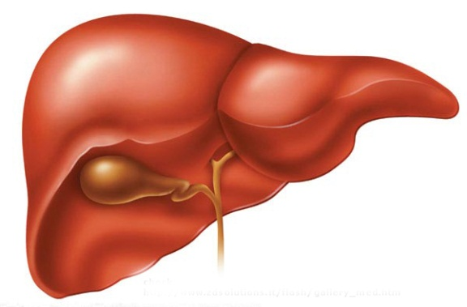
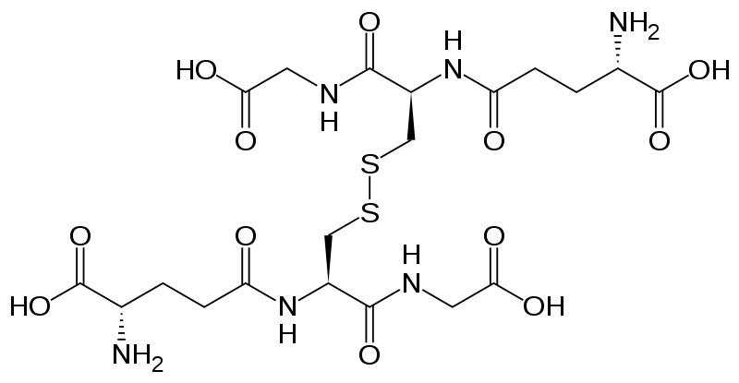
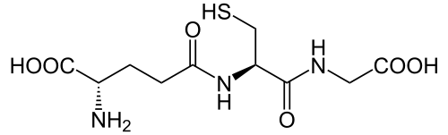
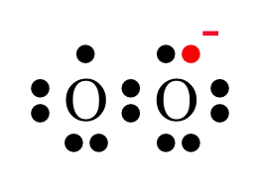
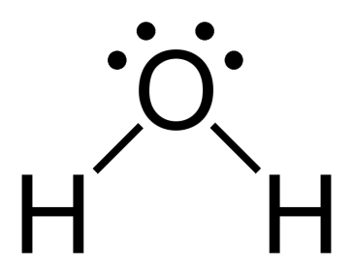
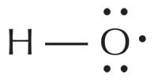
Neal I. Callaghan, Honours Biochemistry student
Reduced glutathione (GSH)
Oxidized glutathione (GSSG)
Superoxide radical anion
OR…
Hydroxyl radical
OR… others…

Slide 27
NADPH
NADP⁺
Glutathione reductase (GR)
Neal I. Callaghan, Honours Biochemistry student
Reduced glutathione (GSH)
Oxidized glutathione (GSSG)
Superoxide radical anion
OR…
Hydroxyl radical
OR… others…

Slide 28
6PGδL
Glucose-6-phosphate dehydrogenase (G6PDH)
G6P
NADPH
NADP⁺
Glutathione reductase (GR)
Neal I. Callaghan, Honours Biochemistry student
Reduced glutathione (GSH)
Oxidized glutathione (GSSG)
Superoxide radical anion
OR…
Hydroxyl radical
OR… others…

Slide 29
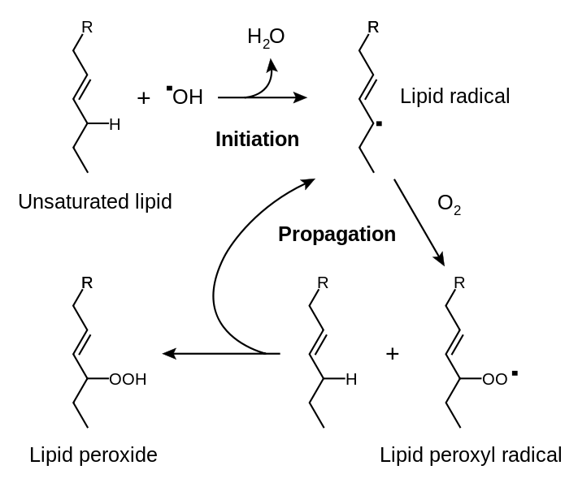
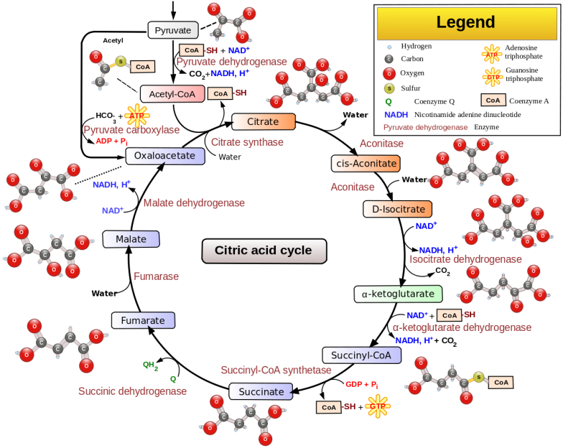
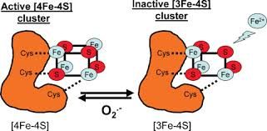
Neal I. Callaghan, Honours Biochemistry student
Wikimedia commons
Wikimedia commons
Armstrong JS et al (2004) Bioessays 26: 894-900

Slide 30
6PGδL
Glucose-6-phosphate dehydrogenase (G6PDH)
G6P
NADPH
NADP⁺
Glutathione reductase (GR)
Neal I. Callaghan, Honours Biochemistry student
Reduced glutathione (GSH)
Oxidized glutathione (GSSG)
Superoxide radical anion
OR…
Hydroxyl radical
OR… others…

Slide 31
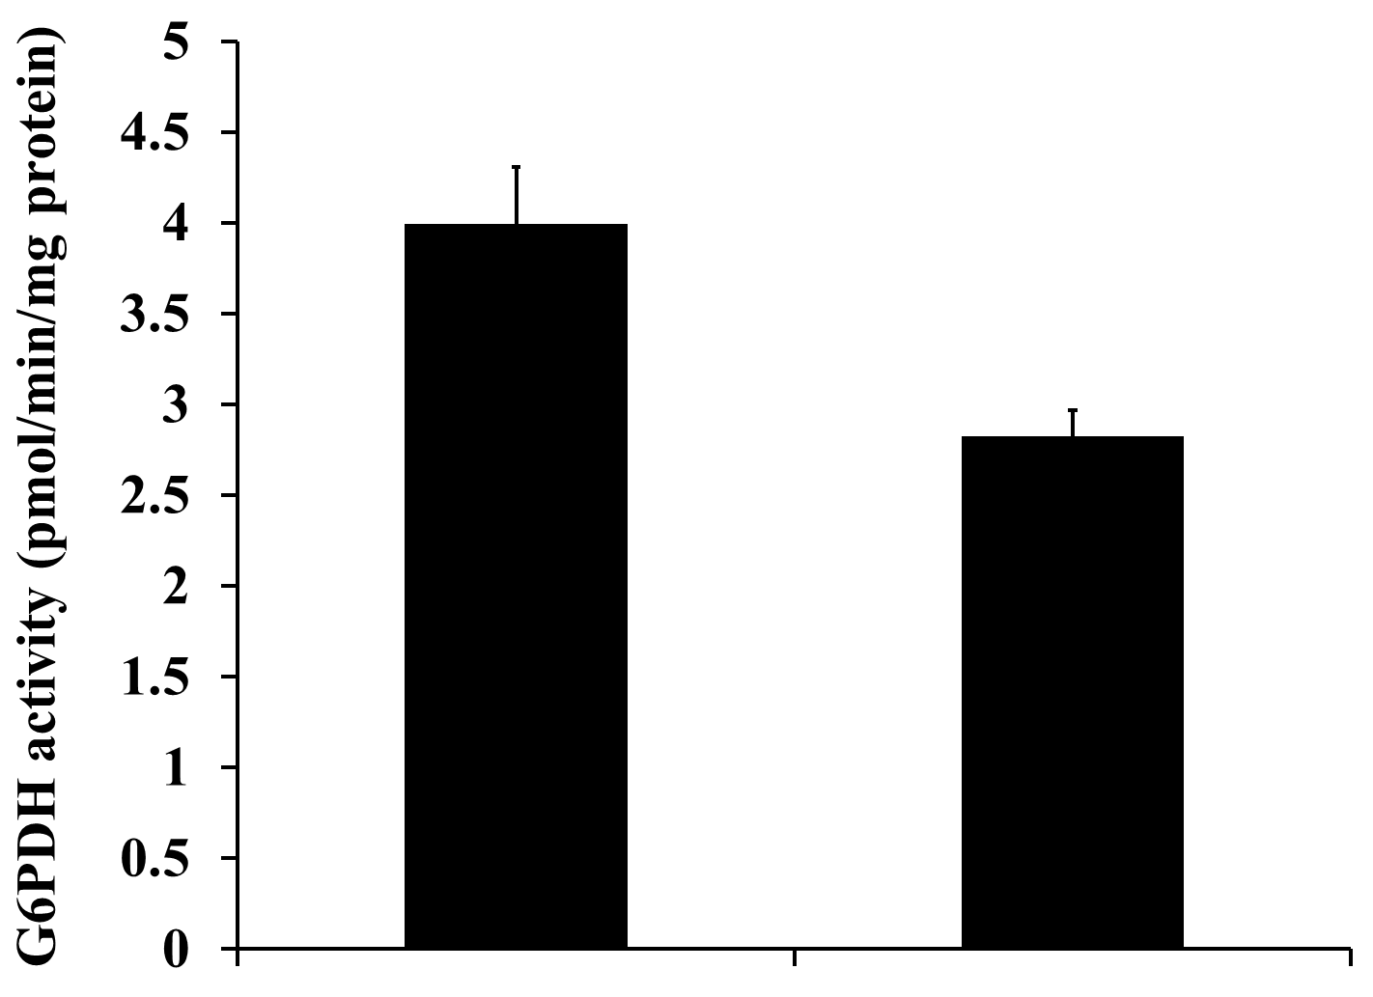
6PGδL
Glucose-6-phosphate dehydrogenase (G6PDH)
G6P
NADPH
NADP⁺
Glutathione reductase (GR)
Neal I. Callaghan, Honours Biochemistry student
a
G6PDH activity decreased with nZnO exposure (~29%)
Reduced glutathione (GSH)
Oxidized glutathione (GSSG)
Control
nZnO
Superoxide radical anion
OR…
Dieni et al. Comp Biochem Physiol Toxicol Pharmacol in press
Hydroxyl radical
OR… others…

Slide 32
6PGδL
Glucose-6-phosphate dehydrogenase (G6PDH)
G6P
NADPH
NADP⁺
Glutathione reductase (GR)
Neal I. Callaghan, Honours Biochemistry student
Reduced glutathione (GSH)
Oxidized glutathione (GSSG)
Superoxide radical anion
OR…
Hydroxyl radical
OR… others…

Slide 33
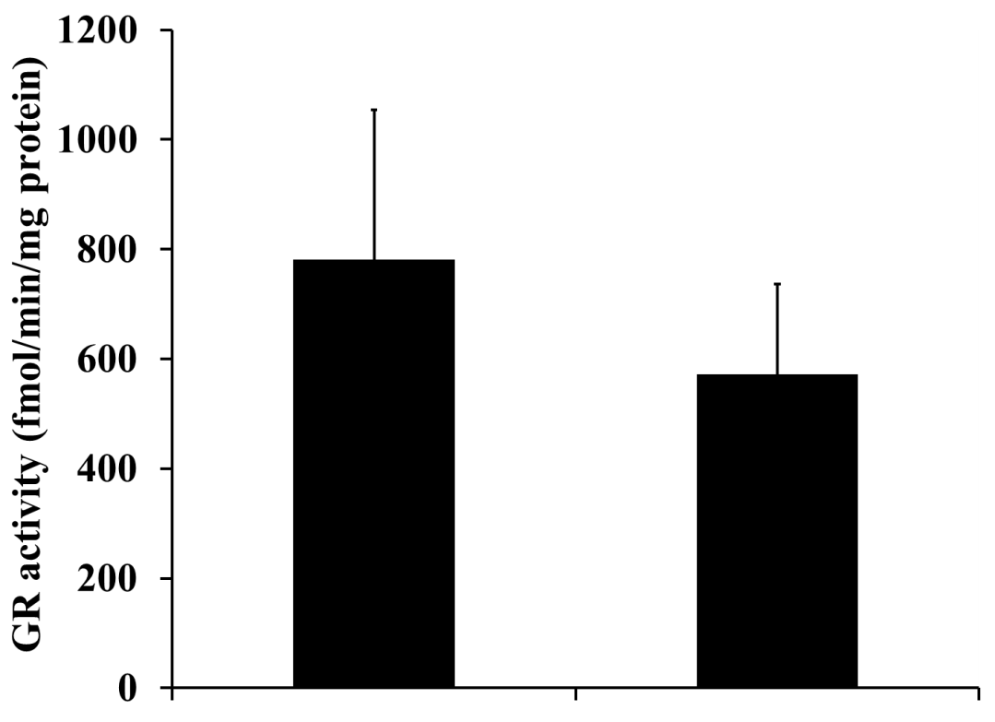
6PGδL
Glucose-6-phosphate dehydrogenase (G6PDH)
G6P
NADPH
NADP⁺
Glutathione reductase (GR)
Neal I. Callaghan, Honours Biochemistry student
Reduced glutathione (GSH)
Oxidized glutathione (GSSG)
GR remained unchanged
Superoxide radical anion
nZnO
Control
OR…
Hydroxyl radical
Dieni et al. Comp Biochem Physiol Toxicol Pharmacol in press
OR… others…

Slide 34
6PGδL
Glucose-6-phosphate dehydrogenase (G6PDH)
G6P
NADPH
NADP⁺
Glutathione reductase (GR)
Neal I. Callaghan, Honours Biochemistry student
Reduced glutathione (GSH)
Oxidized glutathione (GSSG)
Superoxide radical anion
OR…
Hydroxyl radical
OR… others…

Slide 35
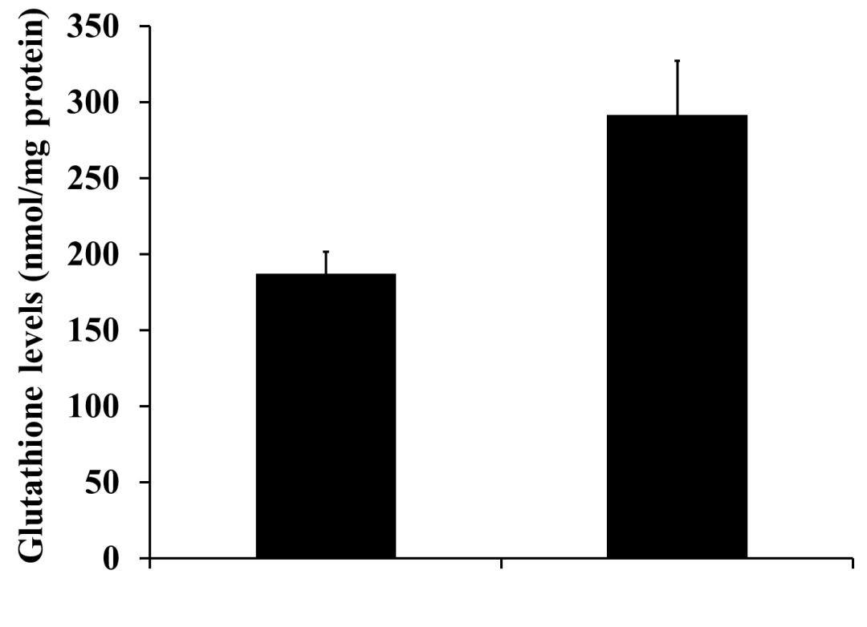
6PGδL
Glucose-6-phosphate dehydrogenase (G6PDH)
G6P
NADPH
NADP⁺
Glutathione reductase (GR)
Neal I. Callaghan, Honours Biochemistry student
a
Reduced glutathione (GSH)
Oxidized glutathione (GSSG)
Total glutathione levels increased with nZnO exposure (~56%)
Superoxide radical anion
nZnO
Control
OR…
Hydroxyl radical
Dieni et al. Comp Biochem Physiol Toxicol Pharmacol in press
OR… others…

Slide 36
Neal I. Callaghan, Honours Biochemistry student
Wikimedia commons
Wikimedia commons
Armstrong JS et al (2004) Bioessays 26: 894-900

Slide 37
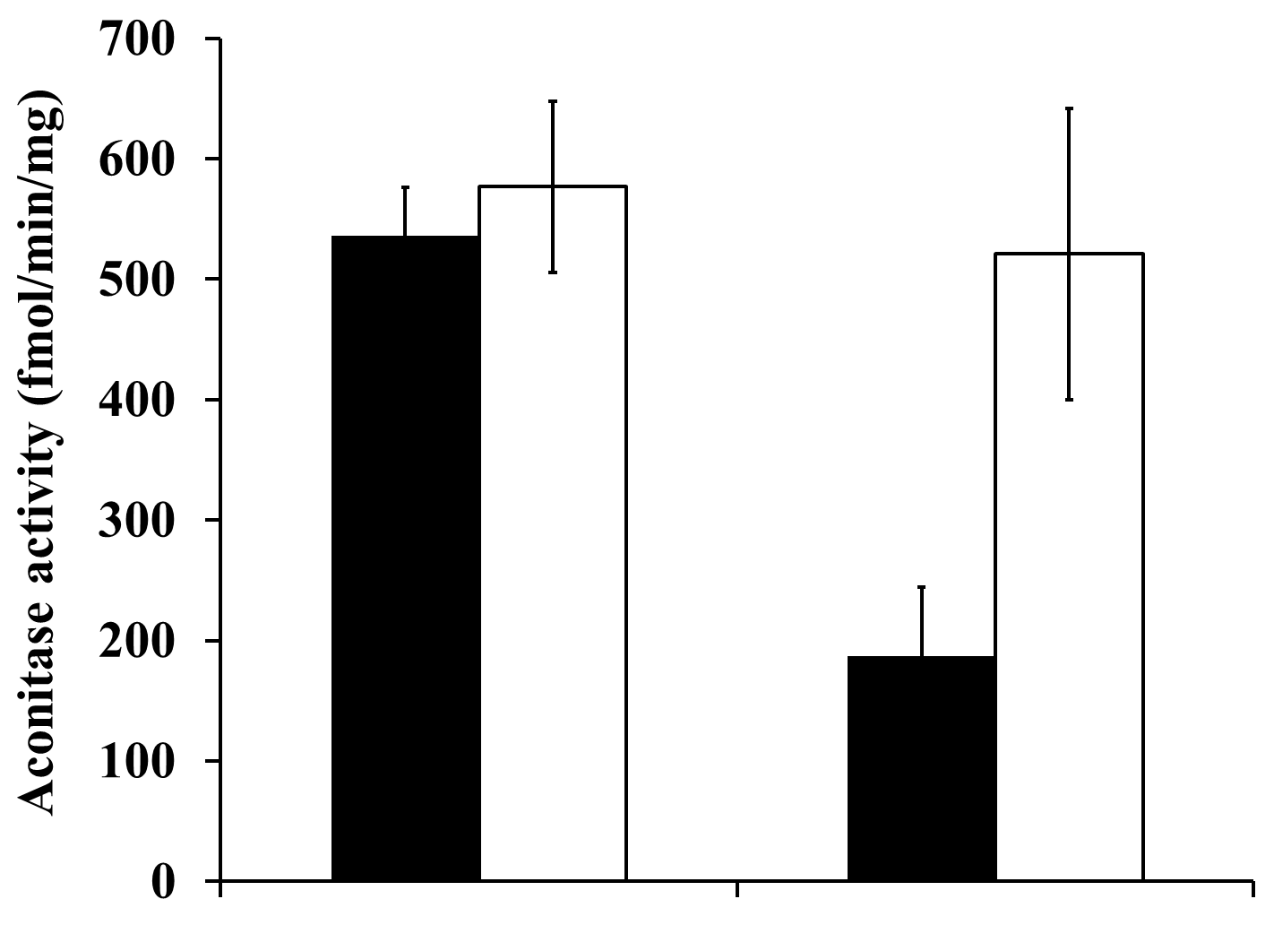
c
Aconitase activity decreased with nZnO exposure (~65%)
Reactivated by supplementation with Fe(NH₄)₂SO₄ (source of Fe²⁺)
b
Neal I. Callaghan, Honours Biochemistry student
Wikimedia commons
Control
nZnO
Dieni et al. Comp Biochem Physiol Toxicol Pharmacol in press
Wikimedia commons
Armstrong JS et al (2004) Bioessays 26: 894-900

Slide 38
Neal I. Callaghan, Honours Biochemistry student
Wikimedia commons
Wikimedia commons
Armstrong JS et al (2004) Bioessays 26: 894-900

Slide 39
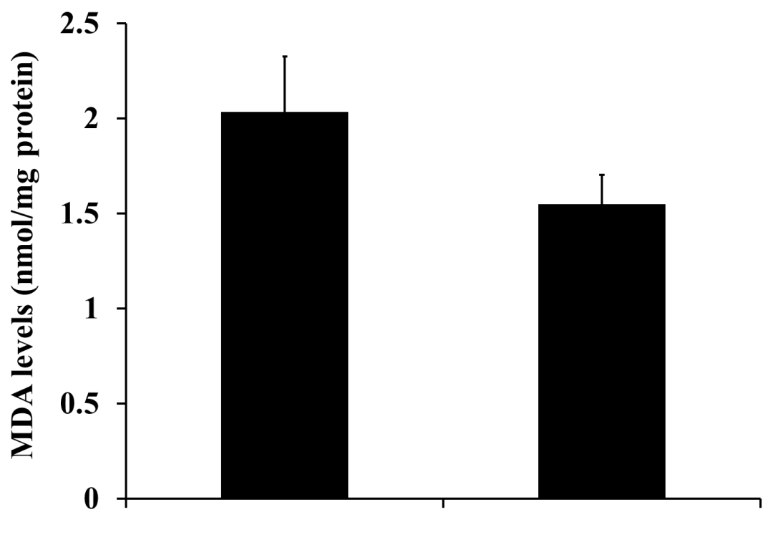
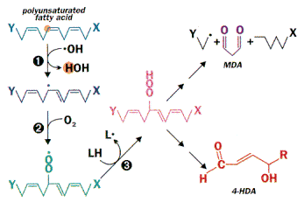
Neal I. Callaghan, Honours Biochemistry student
Malondialdehyde (MDA) levels remained unchanged
Wikimedia commons
Control
nZnO
RND systems
Wikimedia commons
Dieni et al. Comp Biochem Physiol Toxicol Pharmacol in press
Armstrong JS et al (2004) Bioessays 26: 894-900

Slide 40
Hepatic responses to 1 mg/L nZnO exposure
G6PDH | ~29% decrease
GR | -
Glutathione | ~56% increase
Aconitase | ~65% decrease (reactivated by Fe²⁺)
MDA | -
Explanation please…?

Slide 41
6PGδL
Glucose-6-phosphate dehydrogenase (G6PDH)
G6P
NADPH
NADP⁺
Glutathione reductase (GR)
Neal I. Callaghan, Honours Biochemistry student
Reduced glutathione (GSH)
Oxidized glutathione (GSSG)
Superoxide radical anion
OR…
Hydroxyl radical
OR… others…

Slide 42
6PGδL
Glucose-6-phosphate dehydrogenase (G6PDH)
G6P
NADPH
NADP⁺
Glutathione reductase (GR)
Neal I. Callaghan, Honours Biochemistry student
Reduced glutathione (GSH)
Oxidized glutathione (GSSG)
Superoxide radical anion
OR…
Hydroxyl radical
OR… others…

Slide 43
6PGδL
X
G6P
Glucose-6-phosphate dehydrogenase (G6PDH)
X
NADPH
NADP⁺
Glutathione reductase (GR)
Neal I. Callaghan, Honours Biochemistry student
Reduced glutathione (GSH)
Oxidized glutathione (GSSG)
Superoxide radical anion
OR…
Hydroxyl radical
OR… others…

Slide 44
6PGδL
X
G6P
Glucose-6-phosphate dehydrogenase (G6PDH)
X
NADPH
NADP⁺
No activity change, but deficient NADPH
Glutathione reductase (GR)
Neal I. Callaghan, Honours Biochemistry student
Reduced glutathione (GSH)
Oxidized glutathione (GSSG)
Increased de novo biosynthesis bringing total levels up
Superoxide radical anion
OR…
Hydroxyl radical
OR… others…

Slide 45
Neal I. Callaghan, Honours Biochemistry student
Wikimedia commons
Wikimedia commons
Armstrong JS et al (2004) Bioessays 26: 894-900

Slide 46
MDA levels remained unchanged (?)
Neal I. Callaghan, Honours Biochemistry student
Wikimedia commons
Aconitase activity decreased with nZnO exposure (~65%)
Wikimedia commons
Armstrong JS et al (2004) Bioessays 26: 894-900

Slide 47
Nanotoxin?
In vivo exposure
In vitro “exposure”
Live physiological/systemic
(e.g. cardiorespiratory physiology)
Postmortem biochemical assays
(e.g. antioxidant enzymes, damage markers)
Complex media
(e.g. pooled rat blood plasma)
Simplified conditions
(e.g. BSA solution)

Slide 48
Nanotoxin?
In vivo exposure
In vitro “exposure”
Live physiological/systemic
(e.g. cardiorespiratory physiology)
Postmortem biochemical assays
(e.g. antioxidant enzymes, damage markers)
Complex media
(e.g. pooled rat blood plasma)
Simplified conditions
(e.g. BSA solution)

Slide 49
Nanoparticle toxicity
Nel, A. et al. (2006) Toxic potential of materials at the nanolevel. Science 311: 622-627

Slide 50
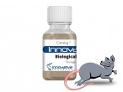
Nanoparticle toxicity
Patrick T. Gormley, Honours Chemistry student
Saline
1% H₂O₂
1 mg/L nZnO
Pooled Sprague Dawley rat plasma
Innovative Research
48 h at 37°C
Nel, A. et al. (2006) Toxic potential of materials at the nanolevel. Science 311: 622-627

Slide 51
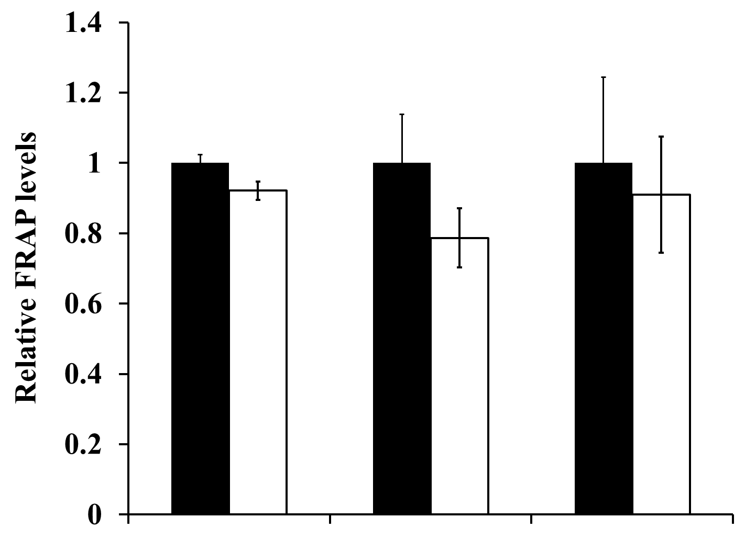
Ferric reducing ability of plasma (FRAP)
A measure of multiple spontaneously electron-donating antioxidants
Unchanged
Nanoparticle toxicity
Patrick T. Gormley, Honours Chemistry student
Saline
1% H₂O₂
1 mg/L nZnO
Pooled Sprague Dawley rat plasma
Innovative Research
Saline
H₂O₂
nZnO
48 h at 37°C
Nel, A. et al. (2006) Toxic potential of materials at the nanolevel. Science 311: 622-627
Dieni et al. Comp Biochem Physiol Toxicol Pharmacol in press

Slide 52
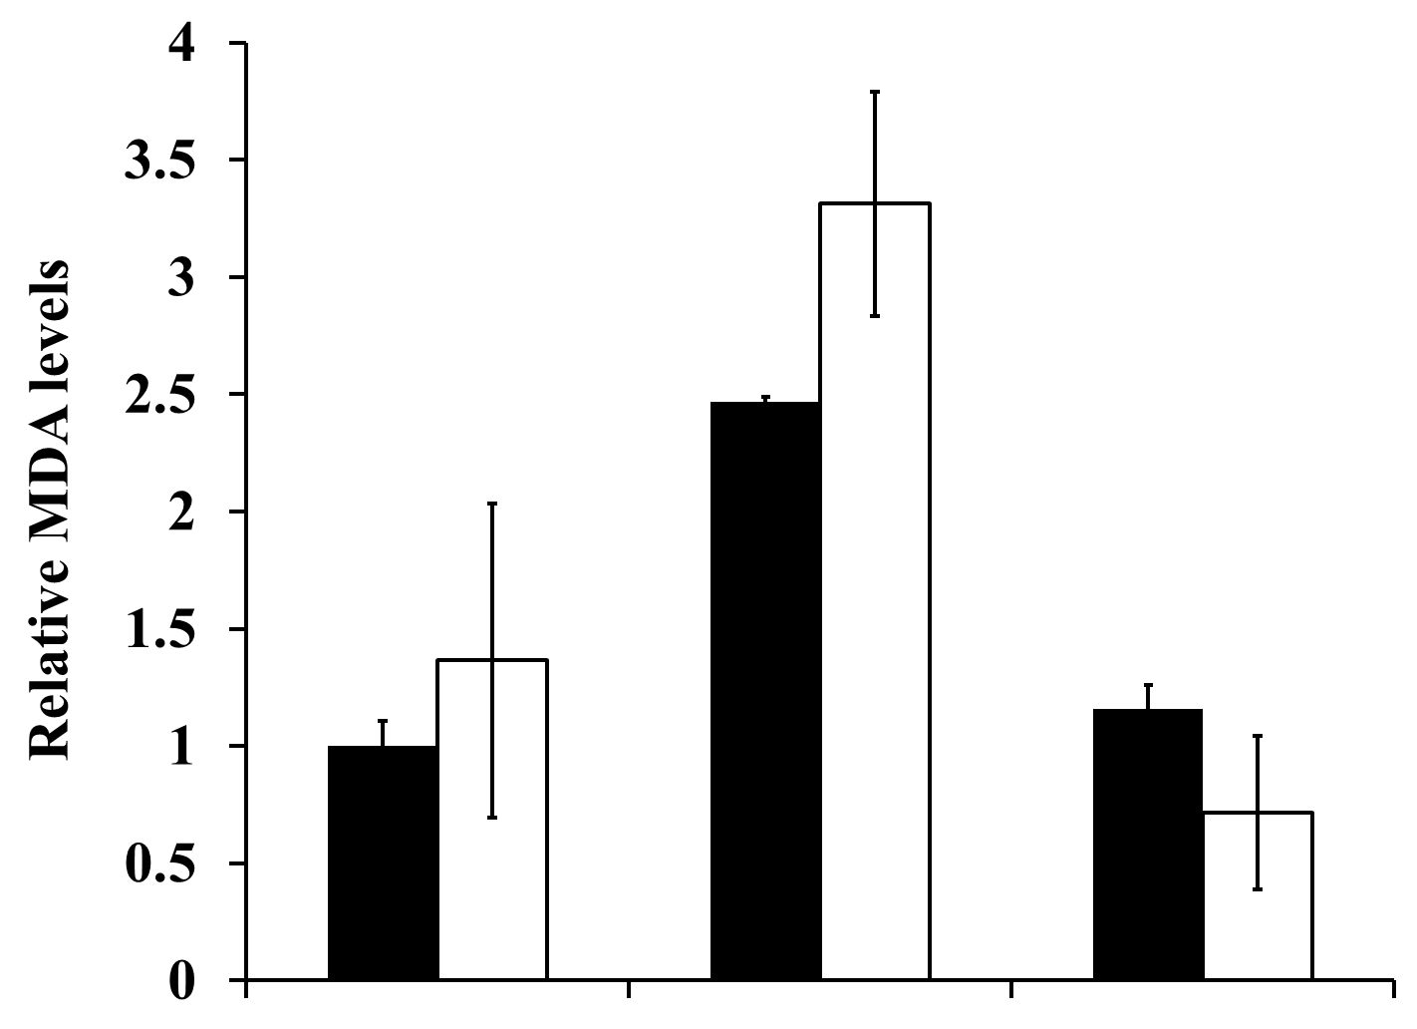
Nanoparticle toxicity
MDA levels remained unchanged
Patrick T. Gormley, Honours Chemistry student
b
a
Saline
RND systems
1% H₂O₂
1 mg/L nZnO
Pooled Sprague Dawley rat plasma
Innovative Research
Saline
H₂O₂
nZnO
48 h at 37°C
Nel, A. et al. (2006) Toxic potential of materials at the nanolevel. Science 311: 622-627
Dieni et al. Comp Biochem Physiol Toxicol Pharmacol in press

Slide 53
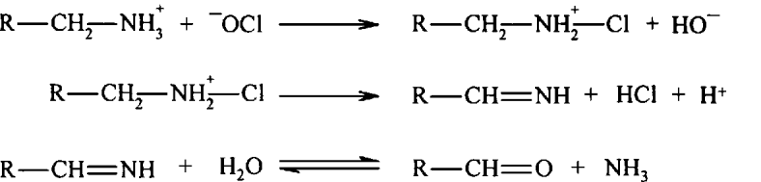
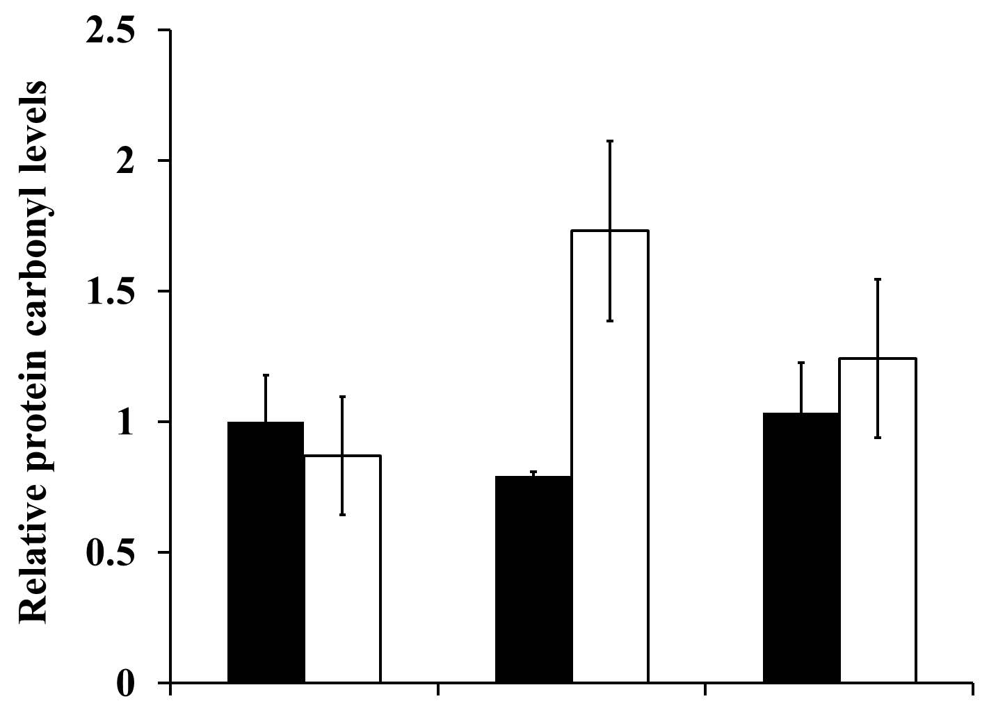
Nanoparticle toxicity
Protein carbonyl levels remained unchanged
Hawkins, CL and Davies, MJ (1998) Biochem J 332: 617-625
Patrick T. Gormley, Honours Chemistry student
c
Saline
1% H₂O₂
1 mg/L nZnO
Pooled Sprague Dawley rat plasma
Innovative Research
Saline
H₂O₂
nZnO
48 h at 37°C
Nel, A. et al. (2006) Toxic potential of materials at the nanolevel. Science 311: 622-627
Dieni et al. Comp Biochem Physiol Toxicol Pharmacol in press

Slide 54

1 mg/L nZnO
In vivo exposure
In vitro exposure
Decreased hepatic G6PDH activity
Decreased hepatic aconitase activity
Increased hepatic glutathione levels
No plasma changes

Slide 55
Nanotoxin?
In vivo exposure
In vitro “exposure”
Live physiological/systemic
(e.g. cardiorespiratory physiology)
Postmortem biochemical assays
(e.g. antioxidant enzymes, damage markers)
Complex media
(e.g. pooled rat blood plasma)
Simplified conditions
(e.g. BSA solution)

Slide 56
Nanotoxin?
No indications of oxidative damage
In vivo exposure
In vitro “exposure”
Live physiological/systemic
(e.g. cardiorespiratory physiology)
Postmortem biochemical assays
(e.g. antioxidant enzymes, damage markers)
Complex media
(e.g. pooled rat blood plasma)
Simplified conditions
(e.g. BSA solution)

Slide 57
Nanotoxin?
In vivo exposure
In vitro “exposure”
↓ heart rate
Live physiological/systemic
(e.g. cardiorespiratory physiology)
Postmortem biochemical assays
(e.g. antioxidant enzymes, damage markers)
Complex media
(e.g. pooled rat blood plasma)
Simplified conditions
(e.g. BSA solution)

Slide 58
Nanotoxin?
↓ G6PDH
↓ aconitase
↓ glutathione
In vivo exposure
In vitro “exposure”
Live physiological/systemic
(e.g. cardiorespiratory physiology)
Postmortem biochemical assays
(e.g. antioxidant enzymes, damage markers)
Complex media
(e.g. pooled rat blood plasma)
Simplified conditions
(e.g. BSA solution)

Slide 59
Nanotoxin?
↓ G6PDH
↓ aconitase
↓ glutathione
No indications of oxidative damage
In vivo exposure
In vitro “exposure”
↓ heart rate
Live physiological/systemic
(e.g. cardiorespiratory physiology)
Postmortem biochemical assays
(e.g. antioxidant enzymes, damage markers)
Complex media
(e.g. pooled rat blood plasma)
Simplified conditions
(e.g. BSA solution)

Slide 60
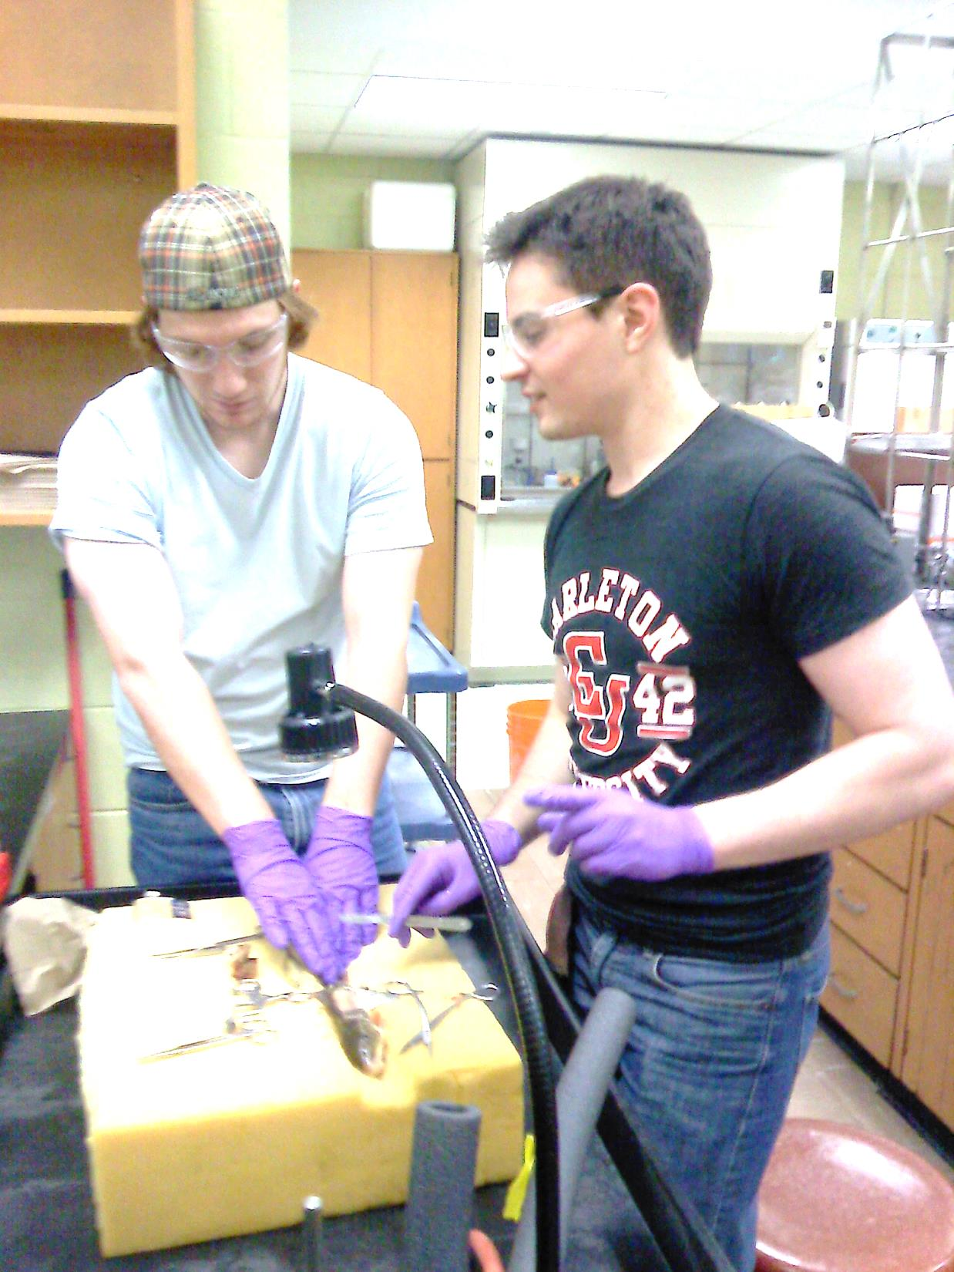



Thank you!
Dieni Research Group
Neal I. Callaghan
Patrick T. Gormley
MacCormack Lab
Dr. Tyson J. MacCormack
Kathryn M. A. Butler
Wayne Anderson – Harold Crabtree Aqualab
James Ehrman – Mount Allison University Digital Microscopy Facility
Dr. Terry Belke and Jackie Jacob-Vogels – Belke Lab rat blood plasma (initial plasma trials)
Maria Thistle – biostatistics (revisions of latest manuscript)
Marjorie Young Bell Fund
Goodridge Summer Research Scholarship
Universitas Summer Undergraduate Award

Slide 61
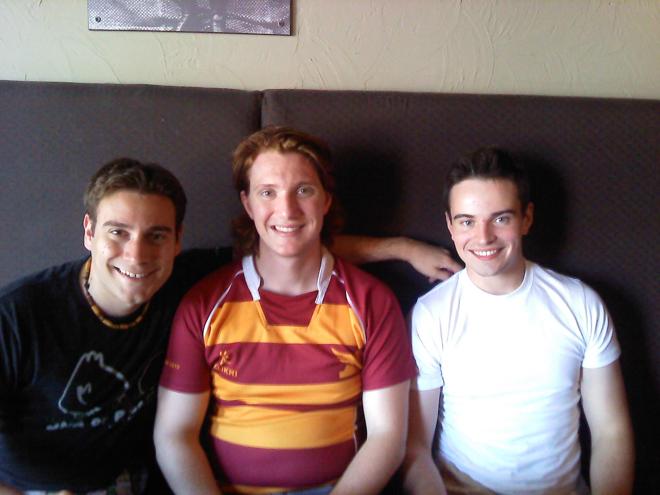
Questions?
Dieni CA, Callaghan NI, Gormley PT, Butler KMA, MacCormack TJ. Physiological hepatic response to zinc oxide nanoparticle exposure in the white sucker, Catostomus commersonii. Comp Biochem Physiol Toxicol Pharmacol in press
Dieni CA, Stone CJL, Armstrong ML, Callaghan NI, MacCormack TJ. 2013. Spherical gold nanoparticles impede the function of bovine serum albumin in vitro: a new consideration for studies in nanotoxicology. J Nanomater Mol Nanotechnol 2:6
cdieni@mta.ca
http://chrisdieni.com
http://www.facebook.com/DieniResearchGroup

